Slide 1
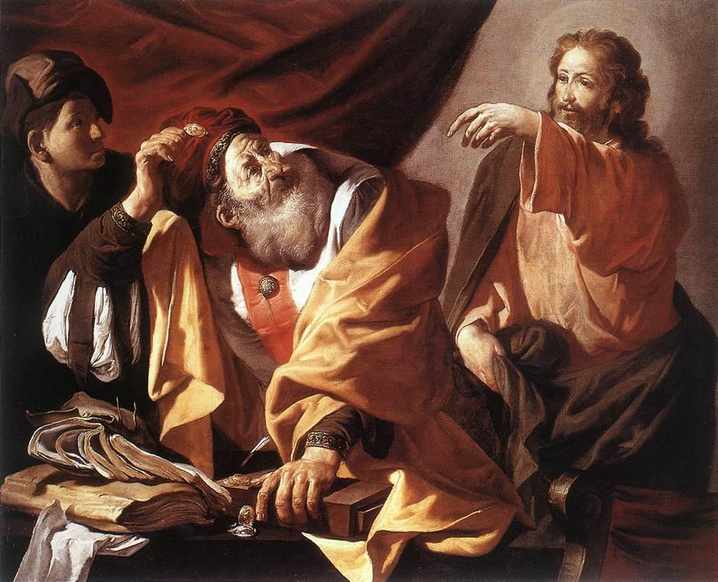
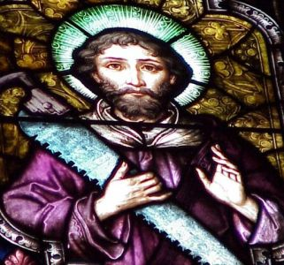
The 12 Apostles: Examples of God’s Mercy in Everyday Life
Sts. Matthew and Simon the Zealot: The Tax Collector and the Terrorist

Slide 2
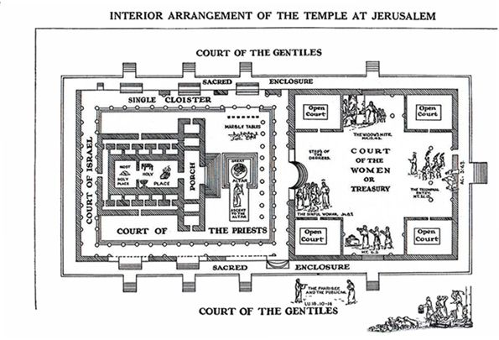

Slide 3
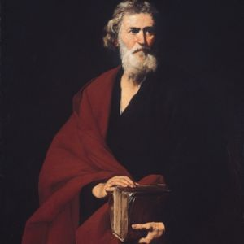
St. Matthew: The Publican
He is known by two names: Levi and Matthew
The most notorious sinner of the 12 apostles who converted
He is a man of humility
Even in his own Gospel account, he only mentions his name twice
He was a Publican or Tax Collector

Slide 4
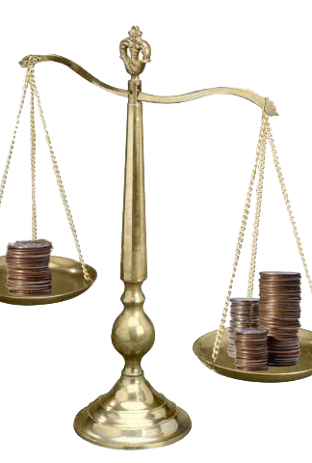
A Publican
They were despised by the Jewish people
They were considered traitors to Israel
More worthy of scorn than the occupying Romans
Considered lower than the Herodians
They bought tax franchises from Rome
Hired thugs to enforce
Were given more for extorting the people of Israel
They were targets of the סיקריים Sicarii

Slide 5
Three types of Tax collectors in the Gospels
Gabbai – General tax collectors
They collected property taxes based on assessments
Mokhes – collected all other taxes
There were two types of Mokhes
Great
Chief tax collector
Zacchaeus was a Great Mokhes
Little
Worked in a tax office
Matthew was a Little Mokhes

Slide 6
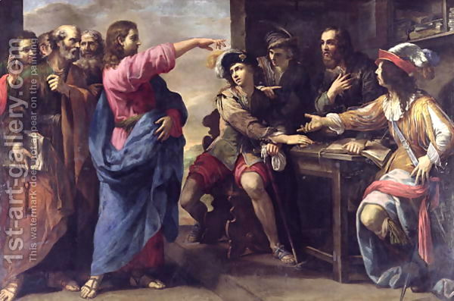
Matthew’s Conversion

Slide 7
After Pentecost
Matthew stayed and preached mainly to the Jewish people
He wrote his Gospel to them
Preached to them in Israel and abroad

Slide 8
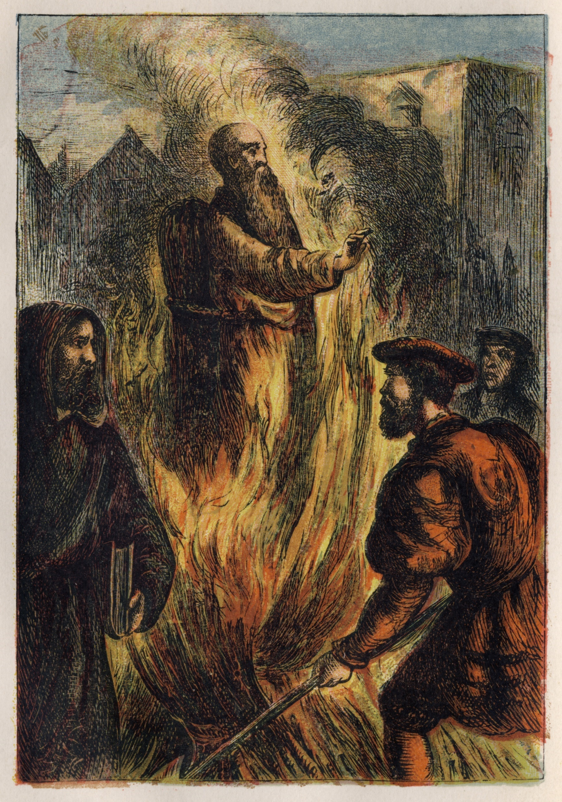
The death of St. Matthew
Tradition tells us that St. Matthew was burned at the stake for his teachings
There is no reliable evidence to prove this

Slide 9
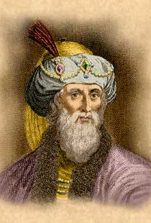
There were four basic parties among the Jews
Pharisees – Fundamentalists
Fastidious about the law
Sadducees – Religious Liberals
Control of the temple
Did not believe in the supernatural
Essenes – not mentioned in the Bible
Devoted their lives to the study of Scripture
Described as celibates
Zealots – extremists
Advanced their agenda through terrorism and acts of violence
Josephus
the historian

Slide 10
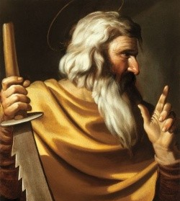
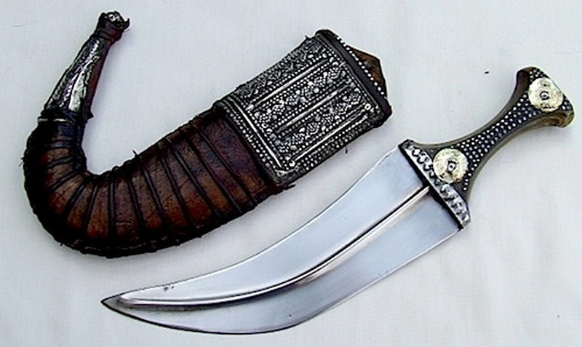
St. Simon the Zealot and Terrorist
Sacarii were named for the knife that they carried
Also known as dagger men
Sought to overthrow Rome and kill those who supported Rome
Including Tax Collectors

Slide 11
“There is no saint without a past, no sinner without a future.”

Slide 12
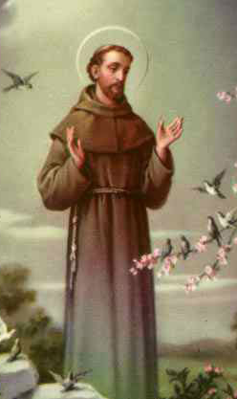
“There is no saint without a past, no sinner without a future.”

Slide 13
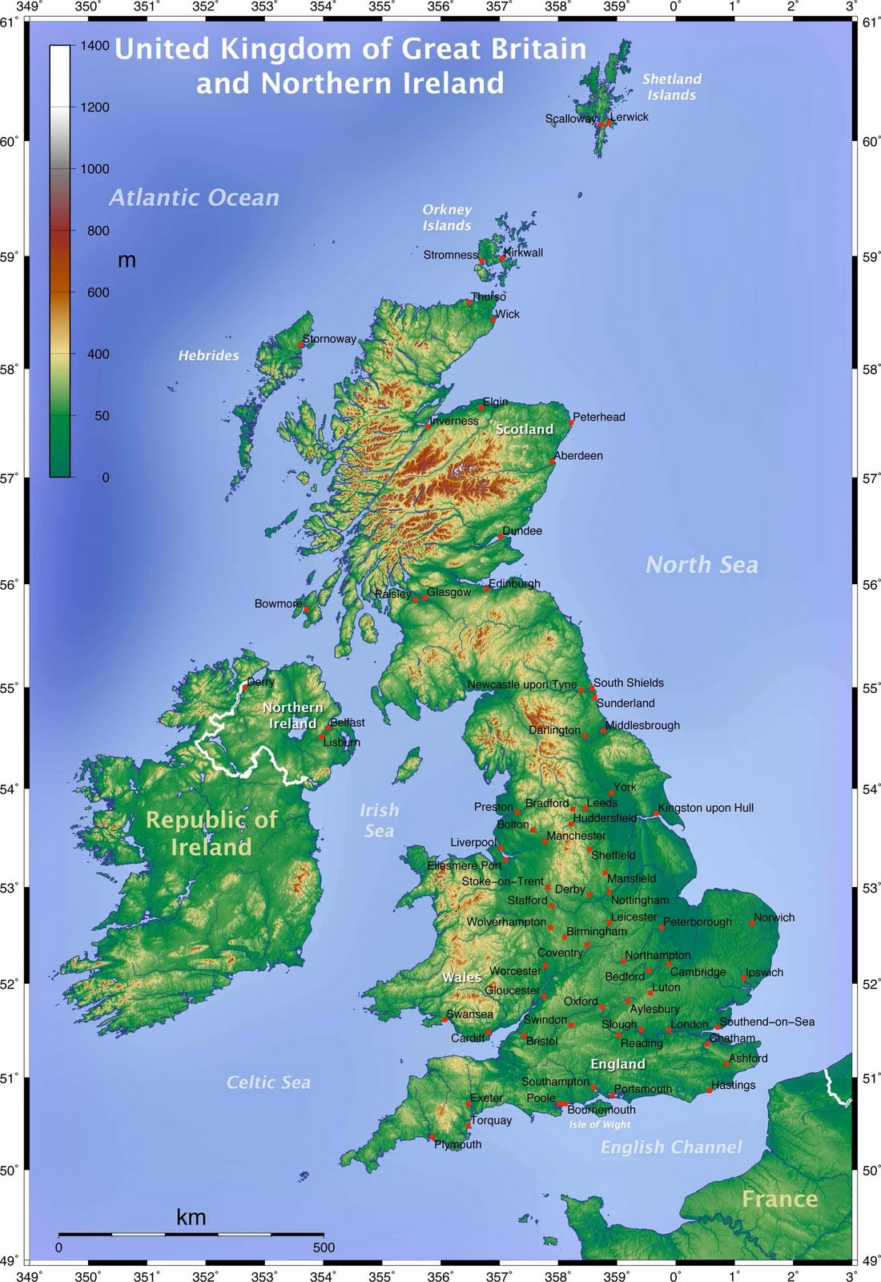
After Pentecost
Simon is said to have traveled to the British Isles
Part of the Roman Empire at the time

Slide 14
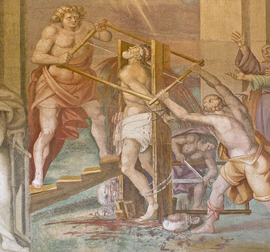
The death of St. Simon
Tradition tells us that St. Sawed in half for his teachings
This is why he is often pictured with a saw in his hands

Slide 15
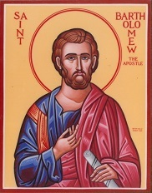
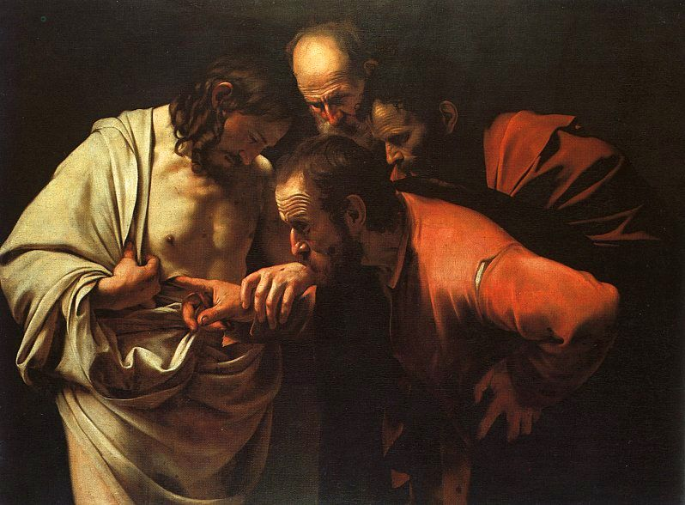
The 12 Apostles: Examples of God’s Mercy in Everyday Life
Sts. Nathanael and Thomas: The True Believer? and the Doubter

