Slide 1
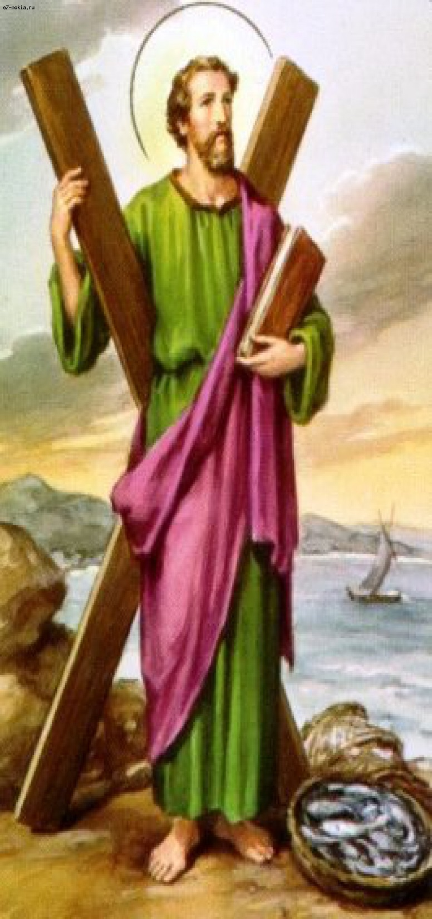
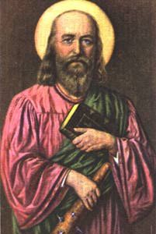
The 12 Apostles: Examples of God’s Mercy in Everyday Life
Sts. Andrew and Philip: The Bringer of people and the Bean Counter

Slide 2
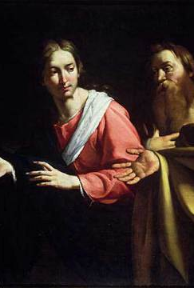
St. Andrew: The Bringer of People
His name was actually Greek (Ἀνδρέας) for Manly
Because of the Hellenization of the Jewish people
He was the brother of St. Peter
Andrew was the first follow Jesus as the Messiah

Slide 3
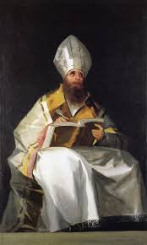
St. Ambrose
While speaking in 386 A.D., St. Augustine came to hear him speak
He did not come for his theology, but rather his speaking style
This is the “Aha” moment for St. Augustine
Prior to this, God was not important, but rather he sought the “truth”
Augustine was converted in 387 A.D. when he was baptized by St. Ambrose at the Easter Vigil

Slide 4
Russia
Scotland
Claimed they were the descendants of the Scythians
Andrew was the brother of the first Pope, so they sought protection by the Vatican in 1320 A.D.
Traveled up through modern day Russia as far as Kiev
Said to have founded the See of Constantinople in 38 A.D.

Slide 5
St. Philip
His name was actually Greek (Φίλιππος) for Lover of horses
He is the fifth name on every list of Apostles
He grew up in the same area as Sts. Peter, and Andrew
He was the first of the Apostles to be called by Jesus

Slide 6
His personality
Seeking heart
Ears, eyes, and heart were open to the call
Facts and figures
Evangelistic heart – called Nathaniel
Missing the big picture
“we can’t do that” as opposed to “we could try this”

Slide 7
They shared more differences than similarities

Slide 8
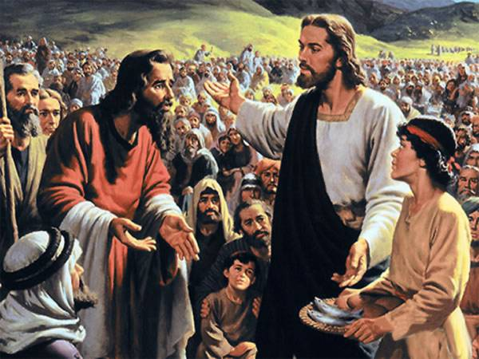
Feeding of the 5,000 “men”
Philip misses the opportunity
Probably 10 or 20 thousand (John 6)
This is where Philip gets the nickname “the Bean Counter”
Andrew went out and found the boy and brought him to Jesus
Jesus knew what He would do, but tested Philip first by showing him what he was like
Andrew saw the possibility

Slide 9
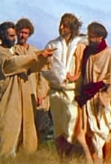
John 12:21 – The Greeks
Gentiles came to Philip to be introduced
Philip didn’t know what to do
Andrew brought them to Jesus without hesitation
This is where he gets the name “The bringer of People”

Slide 10
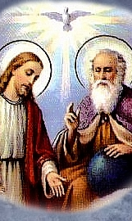
“Show us the Father”
John 14 shows the Apostles still not understanding who Jesus actually was before He entered His Passion
So Philip spoke up
Jesus stated in the clearest possible language that He is God

Slide 11
After the Gospels
Both men are not heard from often if at all
Philip the Deacon is a different person
Andrew’s personality put him in the background
Through Philip multitudes came to Christ because of his teachings

Slide 12
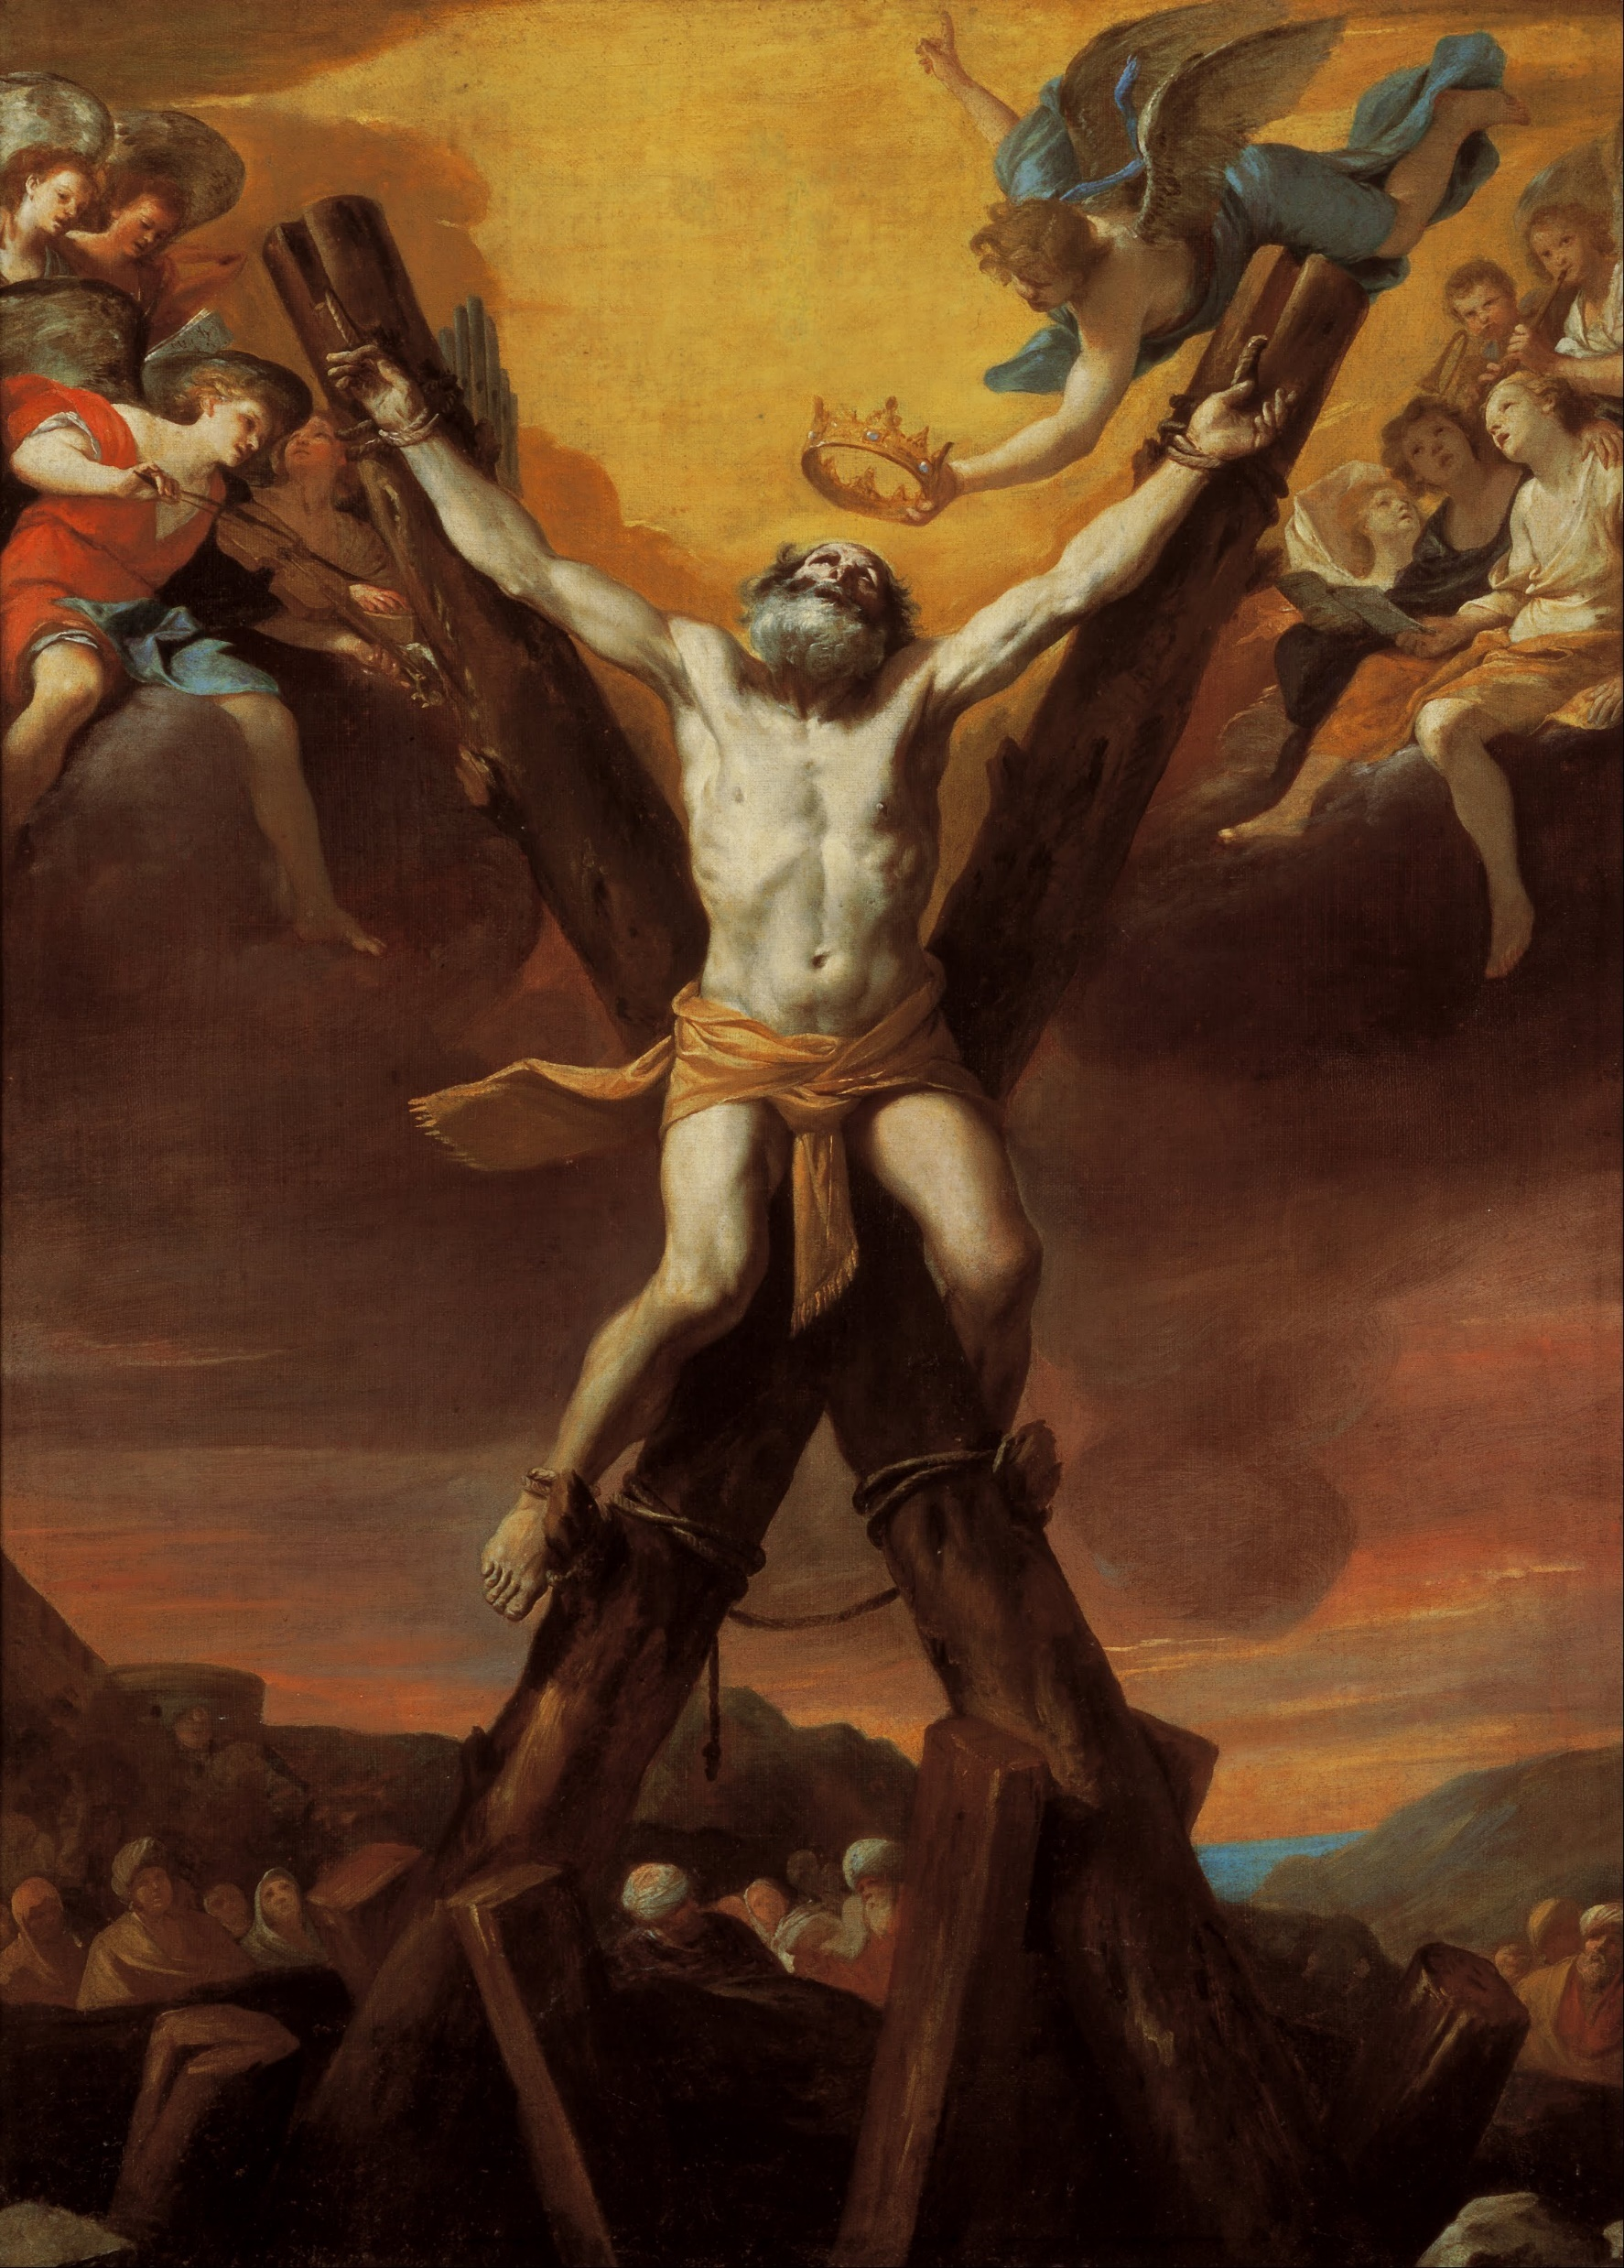
Andrew suffered death by crucifixion
Tradition tells that he was lashed (not nailed) to a saltire
An “X” shaped cross
He would suffer longer
To his last breath, Andrew was said to have been preaching the Gospel and converting passersby during those two days

Slide 13
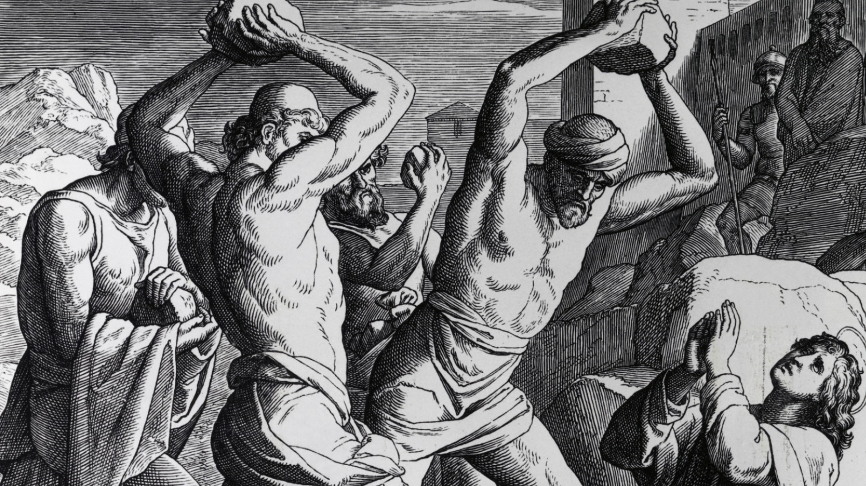
Death: Stoning
St. Philip was stoned to death for his beliefs and teachings
One of the first Apostles to be martyred
Around 52 A.D.

Slide 14
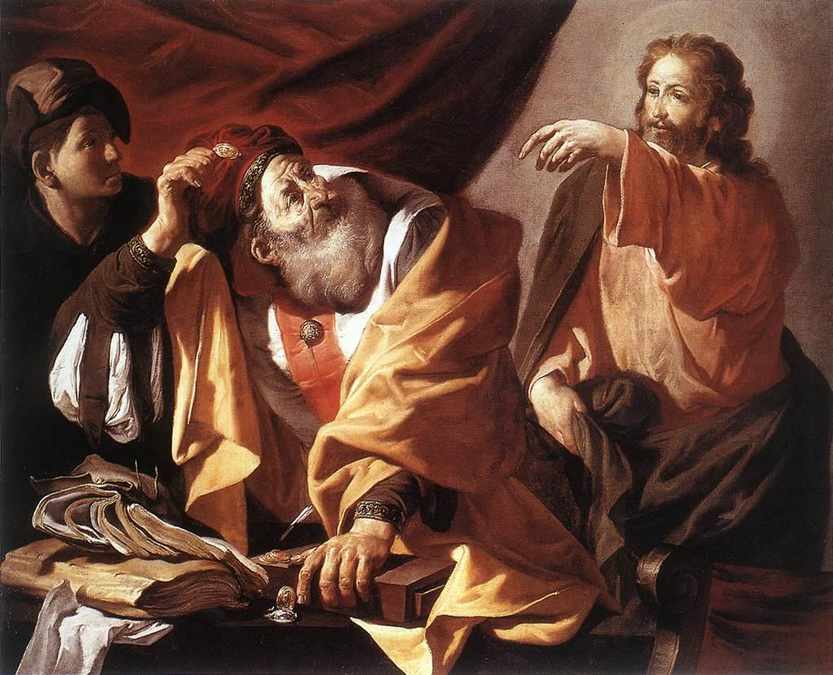
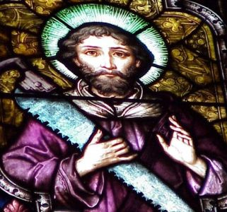
The 12 Apostles: Examples of God’s Mercy in Everyday Life
Sts. Matthew and Simon the Zealot: The Tax Collector and the Terrorist

