Slide 1
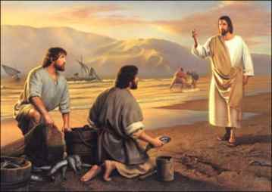
The 12 Apostles: Examples of God’s Mercy in Everyday Life
Sts. James and John: The Sons of Thunder

Slide 2
“James son of Zebedee and John the brother of James (to whom he gave the name Boanerges, that is, Sons of Thunder);”

Slide 3
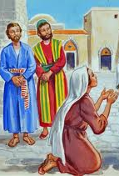
They had their mother ask for their honor
Matthew 20:20-28
They thought they should be given the place of honor
They did not understand for what they were asking
Nor what came with that honor

Slide 4
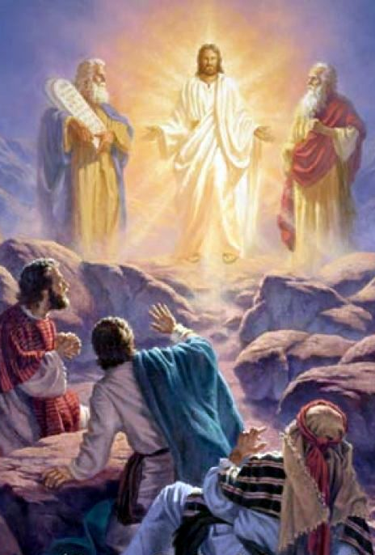
They were witnesses to the Transfiguration
Matthew 17
⁵ While he was still speaking, suddenly a bright cloud overshadowed them, and from the cloud a voice said, “This is my Son, the Beloved;^{[c]} with him I am well pleased; listen to him!” ⁶ When the disciples heard this, they fell to the ground and were overcome by fear. ⁷ But Jesus came and touched them, saying, “Get up and do not be afraid.”

Slide 5
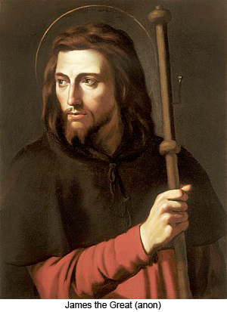
St. James: The Apostle of passion
Part of the inner circle of three
The older brother – giving him the birth right
They came from a wealthy family
The only Apostle to be martyred in the Bible
He was intense, zealous, passionate, thunderous
Had a style that stirred things up
Wanted to call down fire from Heaven to destroy a Samaritan village
Luke 9:54
compared to Elijah in 2 Kings 1:10

Slide 6
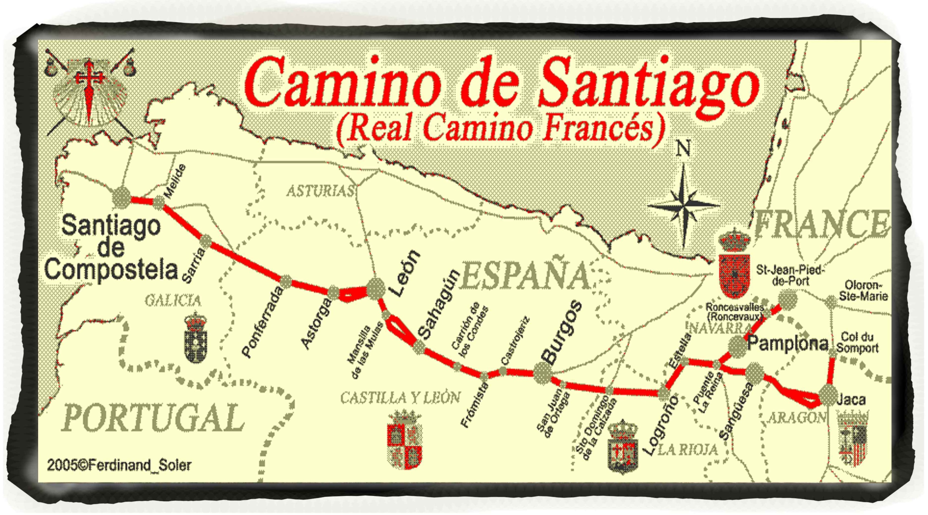

Slide 7
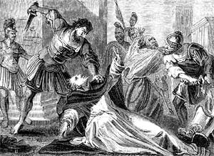
Acts 12:2
St. James was the first Apostle to be martyred
He was beheaded by order of King Herod Agrippa I

Slide 8
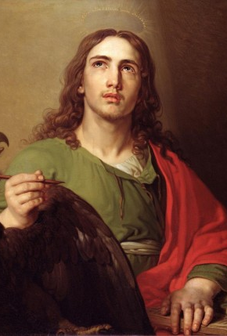
John became a patriarch of the early Church
Known as the Apostle of love
Sought only truth
In his early life, he did this in in all the wrong ways.
He was the first Apostle to the tomb and the only one at the foot of the cross
He was known by the high priest
Condemned a man for casting out demons in the name of Jesus
Mark 9:38

Slide 9
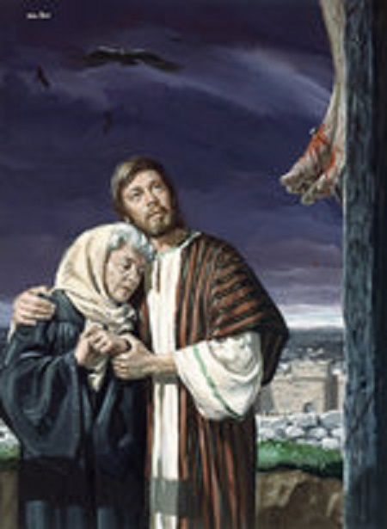
Jesus gave John His mother
John 19:26-27
When Jesus saw his mother and the disciple whom he loved standing beside her, he said to his mother, “Woman, here is your son.” ²⁷ Then he said to the disciple, “Here is your mother.” And from that hour the disciple took her into his own home.

Slide 10
John’s goal changed
Throughout his writings, John uses
Truth 45 times
Love over 80 times

Slide 11
“The capacity to love is determined by the fact that man is ready to seek the good consciously with others, to subordinate himself to this good because of others, or to subordinate himself to others because of this good. Only” ― Pope John Paul II, Love and Responsibility

Slide 12
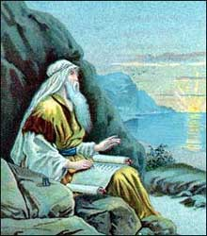
Revelation 1:9
St. John was the only Apostle to not be martyred
He was exiled to Patmos

Slide 13
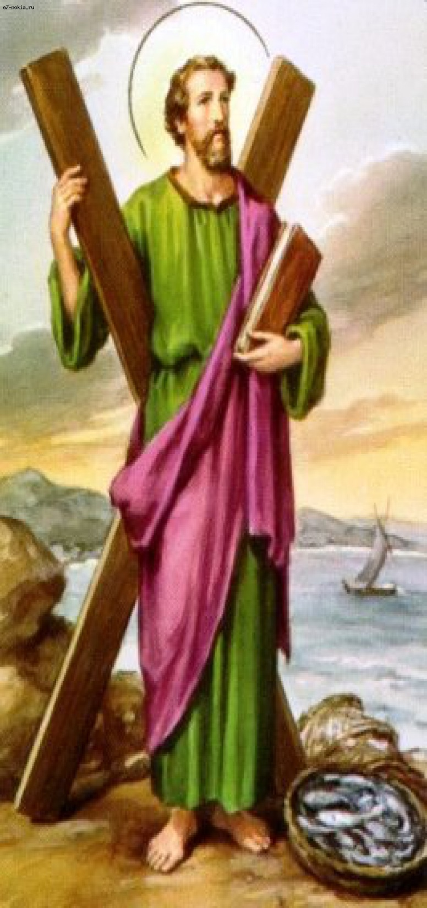
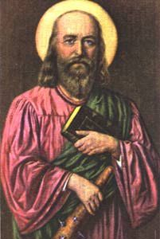
Join us on Wednesday, June 1 as we discover
Sts. Andrew and Philip: The Bringer of people and the Bean Counter

