Slide 1
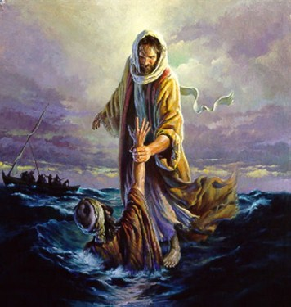
The 12 Apostles: Examples of God’s Mercy in Everyday Life
St. Peter: The Rock

Slide 2
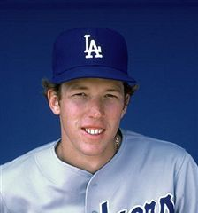
Simon gets a nickname
St. Peter: The Rock

Slide 3
Simon gets a nickname
St. Peter: The Rock

Slide 4
St. Peter was the leader of the 12 Apostles
Not only does Peter head all of the lists, but he is also described this way in Matthew’s Gospel (10:2 NRSVCE)
“These are the names of the twelve apostles: first, Simon, also known as Peter, and his brother Andrew; James son of Zebedee, and his brother John;”
The word on the original Greek is Πρώτος or Prótos

Slide 5
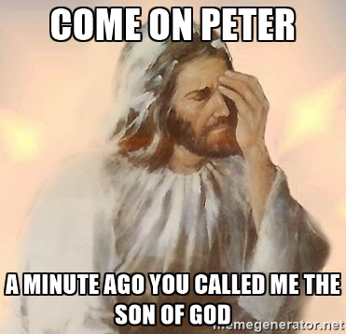
St. Peter was the leader of the 12 Apostles
Simon Peter was the apostle mentioned most in the Gospel narratives.
He is the only apostle to rebuke Jesus, and the one most rebuked by the Lord

Slide 6
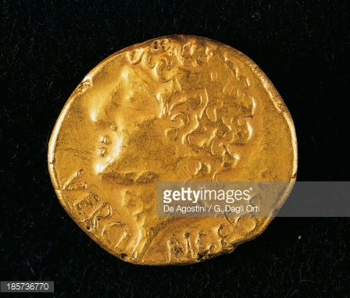
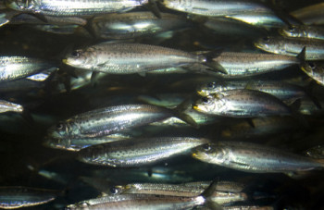
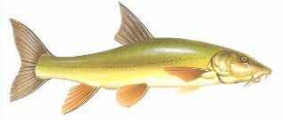
Simon was a fisherman by trade
Stater
Sardines
Musht
Barbel
Enough to pay the temple tax for two people
Called St. Peter’s Fish
Matthew 14:13-21
Matthew 17:27

Slide 7
St. Peter was the leader of the 12 Apostles
What makes a leader?
The right raw material
The right life experience
The right character qualities

Slide 8
The right raw materials: inquisitiveness
Asks lots of questions
Problem solver
Hunger for answers
Matthew 15:15
Luke 12:41
Matthew 18:21
Matthew 17:27
Mark 11:21
John 21:20-22

Slide 9
The change in viewpoint
The washing of the feet in the Gospel (John 13) vs. 1 Peter 4:8

Slide 10
The right raw materials: Initiative
First to answer questions
Charged right in
Acted before thinking
Matthew 16
Luke 22:51
Matthew 26:35
Matthew 26:52

Slide 11
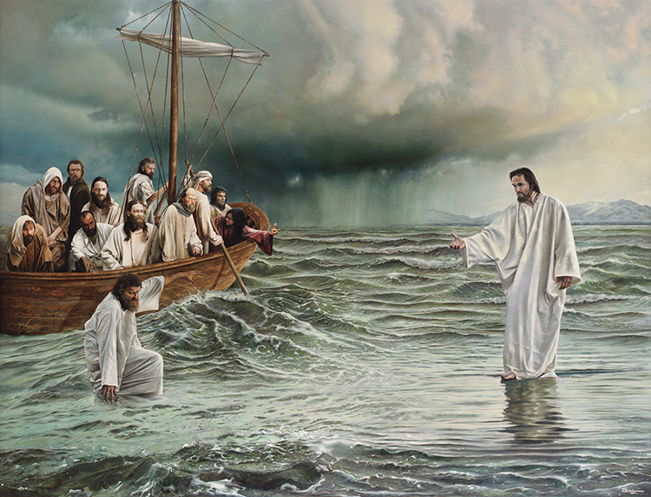
Peter lost faith‽

Slide 12
Peter lost faith‽

Slide 13
The right raw materials: Involvement
In the middle of the action
Must show the way
People can’t follow people someone who remains distant
Matthew 16
Luke 22:51
Matthew 26:35
Matthew 26:52

Slide 14
The change in viewpoint
The contrast between the Peter of the Gospels and the Peter of 1 Peter shows a huge change
John 18
1 Peter 2:21-23

Slide 16
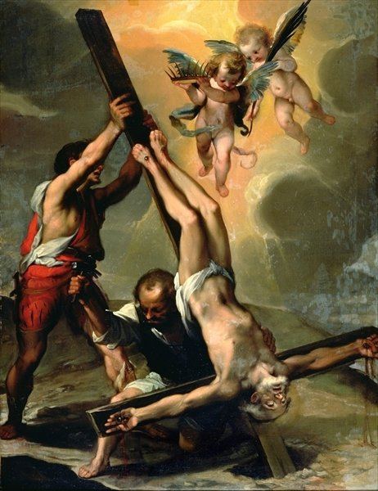
John 21:18
Tradition tells us that St. Peter was crucified upside down

