Slide 1
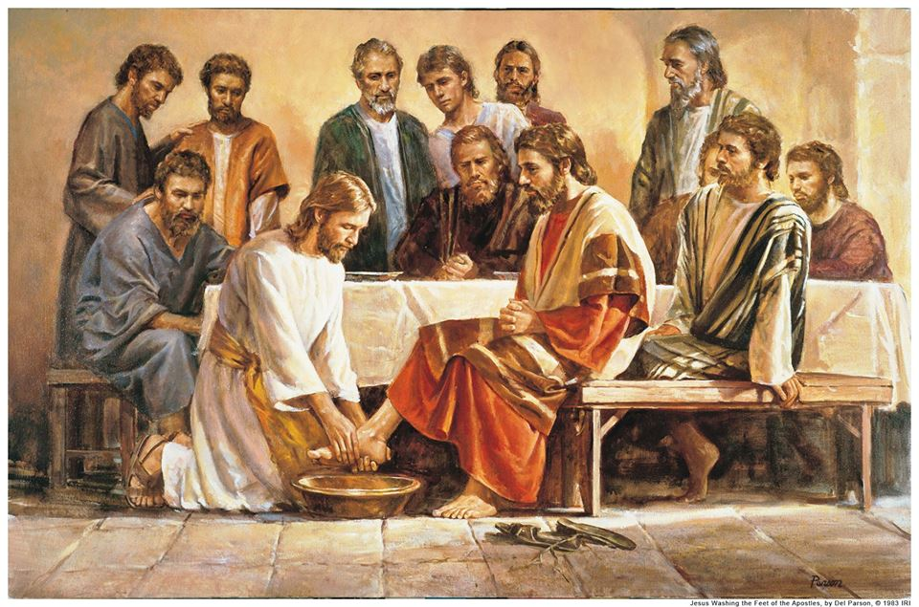
The 12 Apostles: Examples of God’s Mercy in Everyday Life
Who were the Apostles?

Slide 2
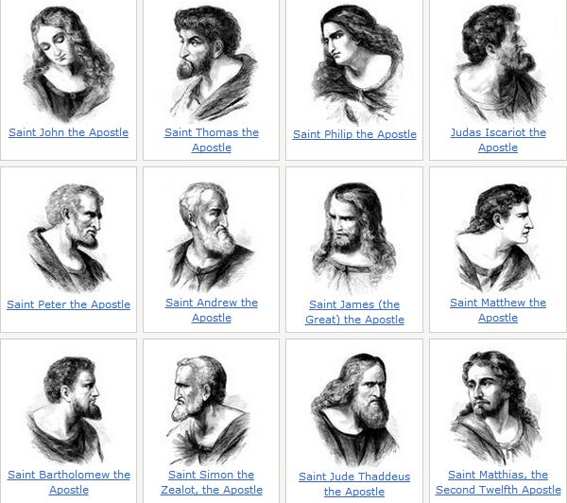
Which Apostle are you most like?

Slide 4
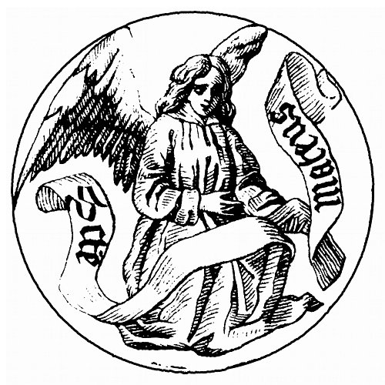
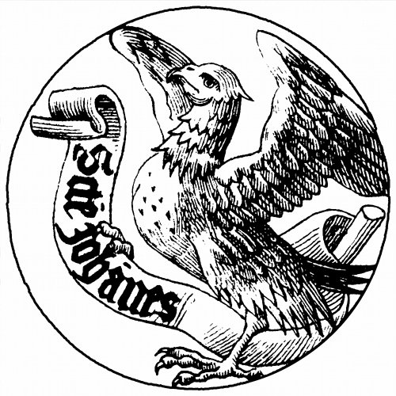
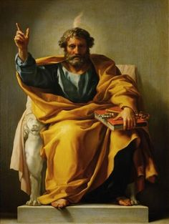
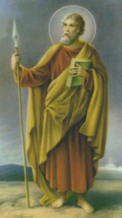
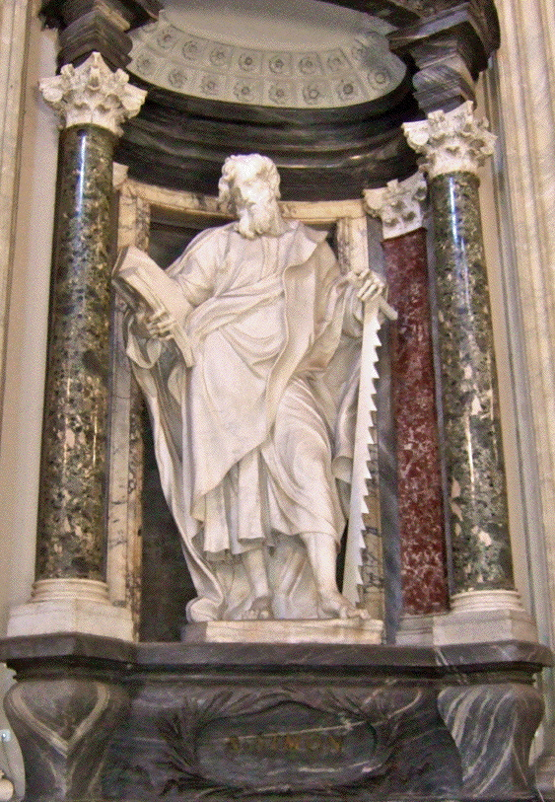
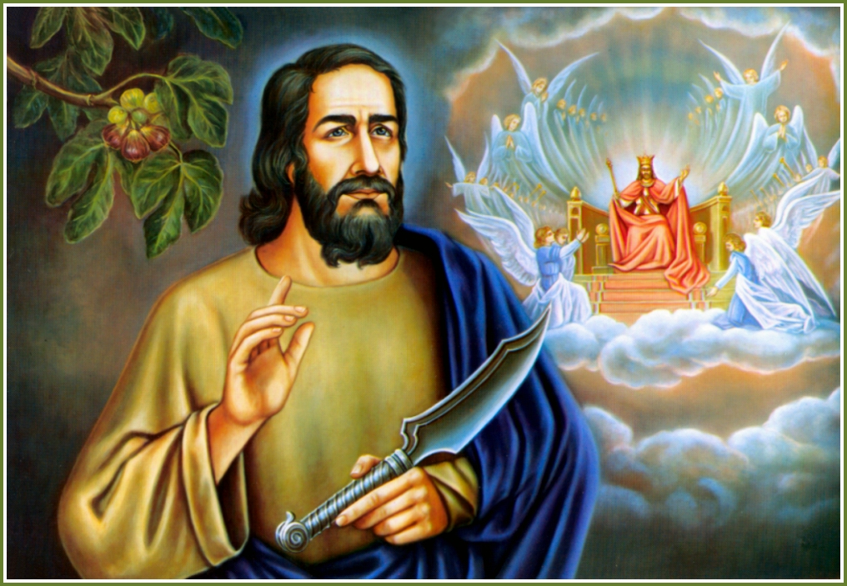

Slide 5
The 12 Apostles: Who were they?
Peter
Andrew
James
John
Thomas
Simon
Bartholomew
Thaddeus
Judas
Matthew
Philip
James the Less

Slide 6
It’s all ελληνικά to me
(Greek)
It all goes back to the original language: Greek
There were many words used in the Greek language to describe the Disciples and Apostles that show the difference
In Greek
Transliterated
meaning
Biblical location
μαθητής
mathetes
Student or learner
Matt 10:1, 11:1, 20:17; L 9:1
Απόστολοι
apostoloi
(verb) to send out
Matt 10:2, Mark 6:30, J 13:16
μαθητής
apostolos
(noun) Sent ones or he who is sent
J 13:16, L 10
Άγγελος
angelos
messenger
Throughout the Old and New Testaments

Slide 8
The timing was wrong
Phase 2
A calling to ministry - Luke 5 - Mathetes
Called to full-time ministry

Slide 9
They were called in four phases
Phase 1
A calling to conversion – John 1:35-51
Called first to salvation
Phase 2
A calling to ministry - Luke 5 - Mathetes
Called to full-time ministry
Phase 3
A calling to apostleship – Matthew 10:1-4 and Luke 6:12-16 – Apostolos
Chosen from amongst the disciples
Phase 4
A calling to witness – Acts 1:8
They were to be martyrs

Slide 10
The timing was wrong.
Phase 1
A calling to conversion – John 1:35-51
Called first to salvation
Peter, Andrew, John, Philip, and Nathaniel
They were already disciples of John the Baptist.
“Behold the lamb of God”
They remained at their full time jobs
Often seen fishing and mending their nets

Slide 11
The timing was wrong
Phase 2
A calling to ministry - Luke 5 - Mathetes
Called to full-time ministry

Slide 12
Called to be apostles
Phase 3
A calling to apostleship – Matthew 10:1-4 and Luke 6:12-16 – Apostolos
Chosen from amongst the disciples
Luke 6:12
This does not refer to s specific date, or time of day
Refers back to Luke 5:17-6:10
Jesus had upset the religious establishment
Healing a paralytic and forgiving his sins (5:17-26)
Eating and drinking with tax collectors (5:27-29)
Working on the Sabbath (6:6-11)

Slide 13
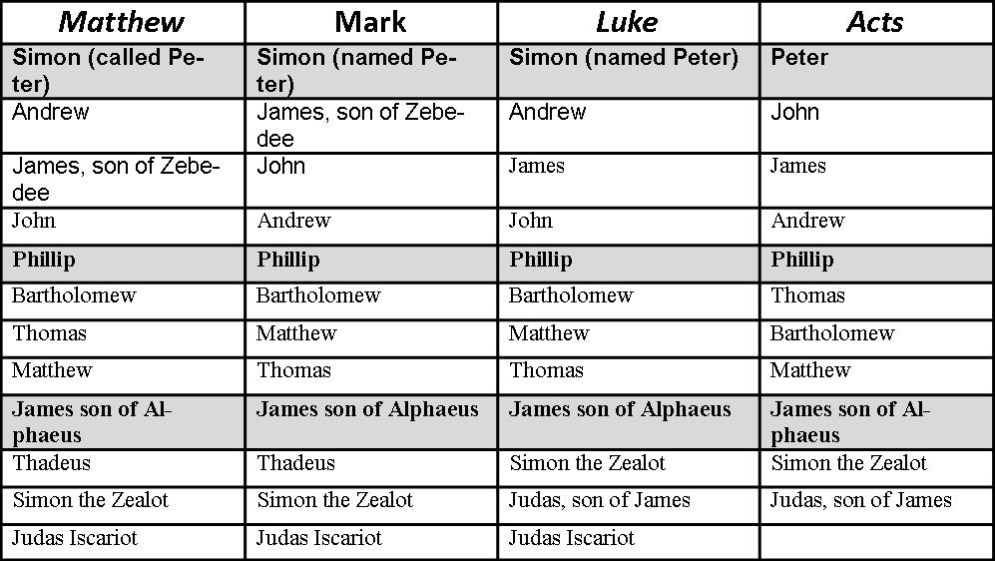

Slide 14
Simon was called “Peter or Rock” not as a statement of his faith, but rather because of his stubbornness of heart
James and John were called the Sons of Thunder or the Boanérges brothers
Andrew is best known for his brother and for bringing people to Christ. He also brought James and John
Philip was the bean counter. Though strong in faith, he was the first to say “but we only have…”
Matthew was a betrayer to his people for money. A tax collector
Simon the Zealot was a terrorist. He was a member of the Sicarii

Slide 15
Bartholomew had a true faith because of his love of the scriptures. He is also know in Scripture as Nathaniel
Thomas was a doubter. Strong of faith, but the first to say “no way”
James was a man of short stature. Not much is known about him because of the number of James’ in the Bible
Thaddeus was also known as Judas (not Iscariot) and Jude, hence he is the man with three names.
Judas Iscariot was the one that betrayed Jesus

Slide 16
They were called in four phases
Phase 4
A calling to witness – Acts 1:8
They were to be martyrs

