Slide 1
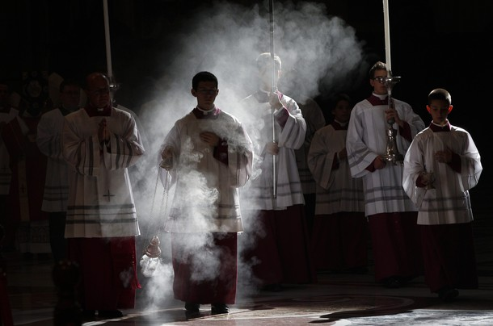
The Liturgy Explained
What is the Mass?

Slide 2
What does the term Liturgy mean?
Lit Urgy
Laos Ergon
People Work
Laity Energy

Slide 3
What does the term Liturgy mean?
The term has a three part meaning
The work of the people
The work of Christ for the people so that we may share in Salvation
The work of God in which the people participate

Slide 4
What did the saints say about the Mass?
“It would be easier for the world to survive without the sun than to do without Holy Mass.” St. Padre Pio
“The Mass is the most perfect form of prayer.” Pope Paul VI
“What graces, gifts and virtues the Holy Mass calls down.” St. Leonard of Port Maurice
“I believe that were it not for the Holy Mass, as of this moment the world would be in the abyss.” St. Leonard of Port Maurice
“If we really understood the Mass, we would die of joy.” St. John Vianney
“Put all the good works in the world against one Holy Mass; they will be as a grain of sand beside a mountain.” St. John Vianney
“When Mass is celebrated, the sanctuary is filled with countless angels who adore the divine victim immolated on the altar.” St. John Chrysostom
Once St. Teresa was overwhelmed with God’s Goodness and asked Our Lord, “How can I thank you?” He replied, “ATTEND ONE MASS.”
“The celebration of Holy Mass is as valuable as the death of Jesus on the cross.” St. Thomas Aquinas
“Without doubt, the Lord grants all favors which are asked of Him in Mass, provided they be fitting for us.” St. Jerome
“A single Mass offered for oneself during life may be worth more than a thousand celebrated for the same intention after death.” St. Anslem

Slide 5
What is the Mass?

Slide 6
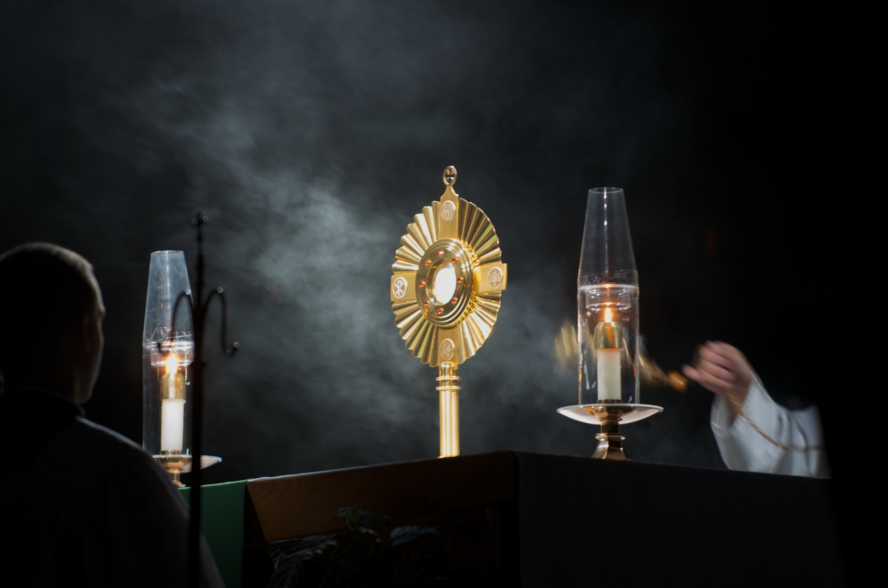
The liturgy is how we grow intimate with God. We are truly in His presence during the holy sacrifice of the Mass.

Slide 7
The liturgy is how we grow intimate with God. We are truly in His presence during the holy sacrifice of the Mass.

Slide 8
The liturgy is how we grow intimate with God. We are truly in His presence during the holy sacrifice of the Mass.

Slide 9
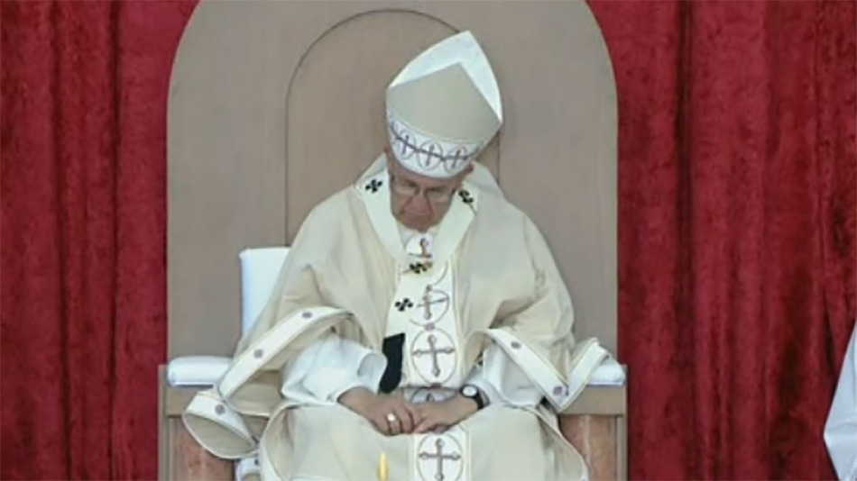
But why is it so boring?
He’s sleeping in the Spirit

Slide 10
But why is it so boring?
He’s sleeping in the Spirit

Slide 11
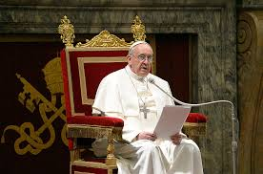
Not so boring anymore!
He’s sleeping in the Spirit

