Slide 1
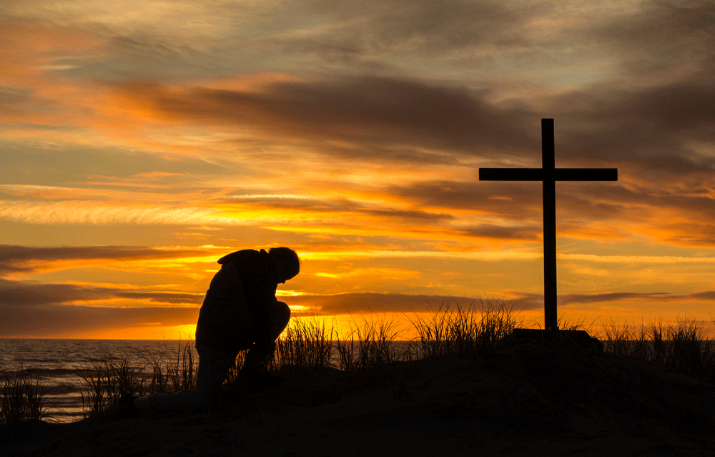
The Liturgy Explained
The Liturgy Explained
The Introductory Rites
The Introductory Rites

Slide 2
What is a shibboleth?
שִׁבֳּלִים was the Hebrew word used as a code word to tell true Israelites in Judges 12
The early Christians had a similar symbol that we see in the church every week.

Slide 3
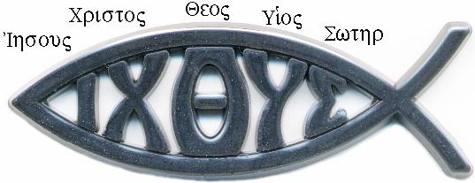
What is an ichthus?
ICHTHUS

Slide 4
The Liturgy Explained
Do you believe in the cross of Christ?
What are you going to do about it?
The Introductory Rites

Slide 5
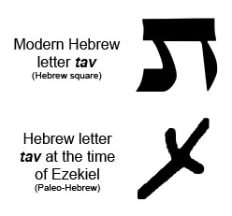
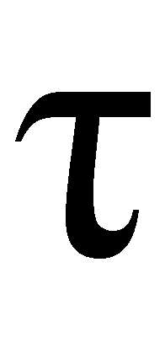
The Sign of the Cross
Ezekiel 9:4
Marked with a symbol of faith on their foreheads
Sign of the cross
Gospel marking
The Tav The Tau

Slide 6
The Sign of the Cross
Ezekiel 9:4
Marked with a symbol of faith on their foreheads
Sign of the cross
Gospel marking
The Tav The Tau

Slide 7
The Lord Be With You
It is called the greeting, but it is so much more than that.
We are calling on the presence of God to this moment
And we respond with “And with your Spirit”
It is the Spirit of God that we are acknowledging

Slide 8
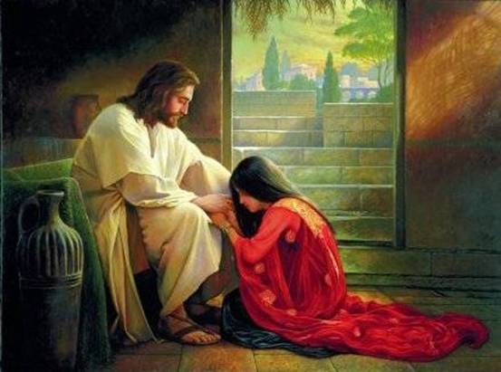
The Penitential Act
We forgive sins during this time
We are called to reflect on what we have done wrong over the past week
In my Thoughts, Words, Done, Not Done

Slide 9
The Penitential Act
We forgive sins during this time
We are called to reflect on what we have done wrong over the past week
In my Thoughts, Words, Done, Not Done

Slide 10
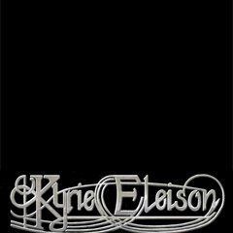
Lord, have mercy
We are asking for God’s Mercy following the Confiteor
God loves to give mercy.
You confessed it and He is forgiving you
We are not only doing this for ourselves, but we are able to do this for others.

Slide 11
Lord, have mercy
We are asking for God’s Mercy following the Confiteor
God loves to give mercy.
You confessed it and He is forgiving you
We are not only doing this for ourselves, but we are able to do this for others.

Slide 12
This is that last part of the Introductory Rites
The priests hand positions have meaning
His arms are spread wide gathering us in

