Slide 1
The Liturgy Explained

Slide 4
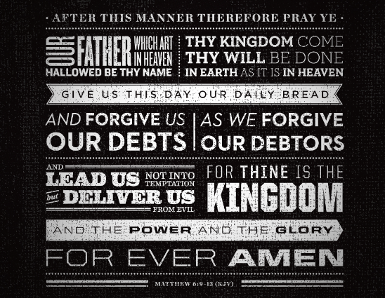

Slide 5
Behold the Lamb of God who takes away the sins of the world

Slide 6
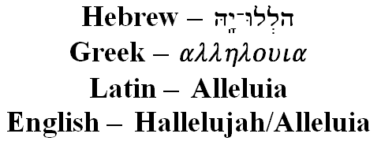
Supper of the Lamb

Slide 7
Revelation 19
Alleluia is only found four times in the New Testament. This brings to mind the Hallel Psalms

Slide 8
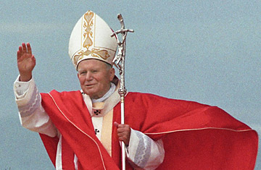
Each time we receive the Eucharist we become like Mary

Slide 9
Each time we receive the Eucharist we become like Mary

Slide 10
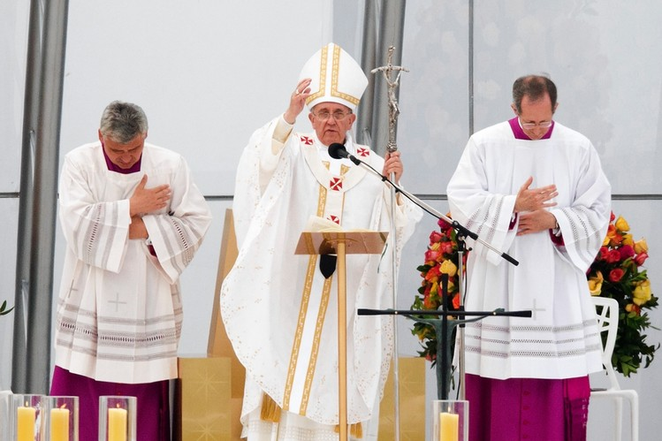
Missio
This is the sending forth.
The Mass ends with a sending forth with a mission to go and preach the Gospel to all people.

