Slide 1
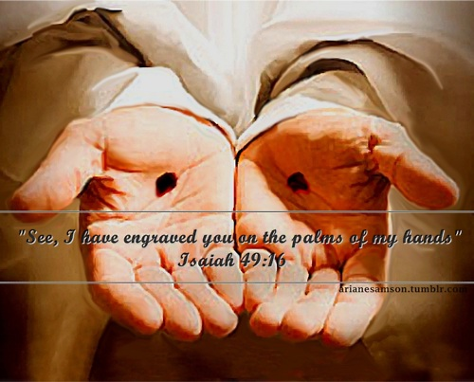
Lent: Mercy Within Yourself
Presented by: Jon Gerstmyer

Slide 2
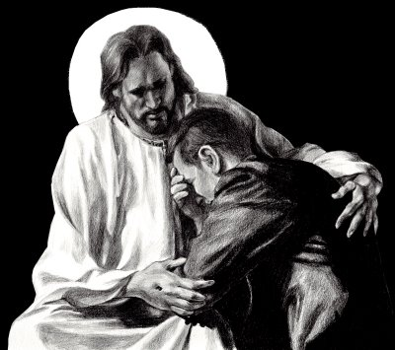
Examining ourselves in the arms of God

Slide 3
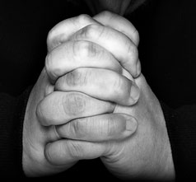
What is Scrupulosity? A form of Obsessive Compulsive Disorder involving religious or moral obsessions. Scrupulous individuals are overly concerned that something they thought or did might be a sin or other violation of religious or moral doctrine. What are the symptoms of scrupulosity? Common obsessions seen in scrupulosity include excessive concerns about: • Blasphemy • Having committed a sin • Behaving morally • Purity • Going to hell • Death • A loss of impulse control

Slide 4
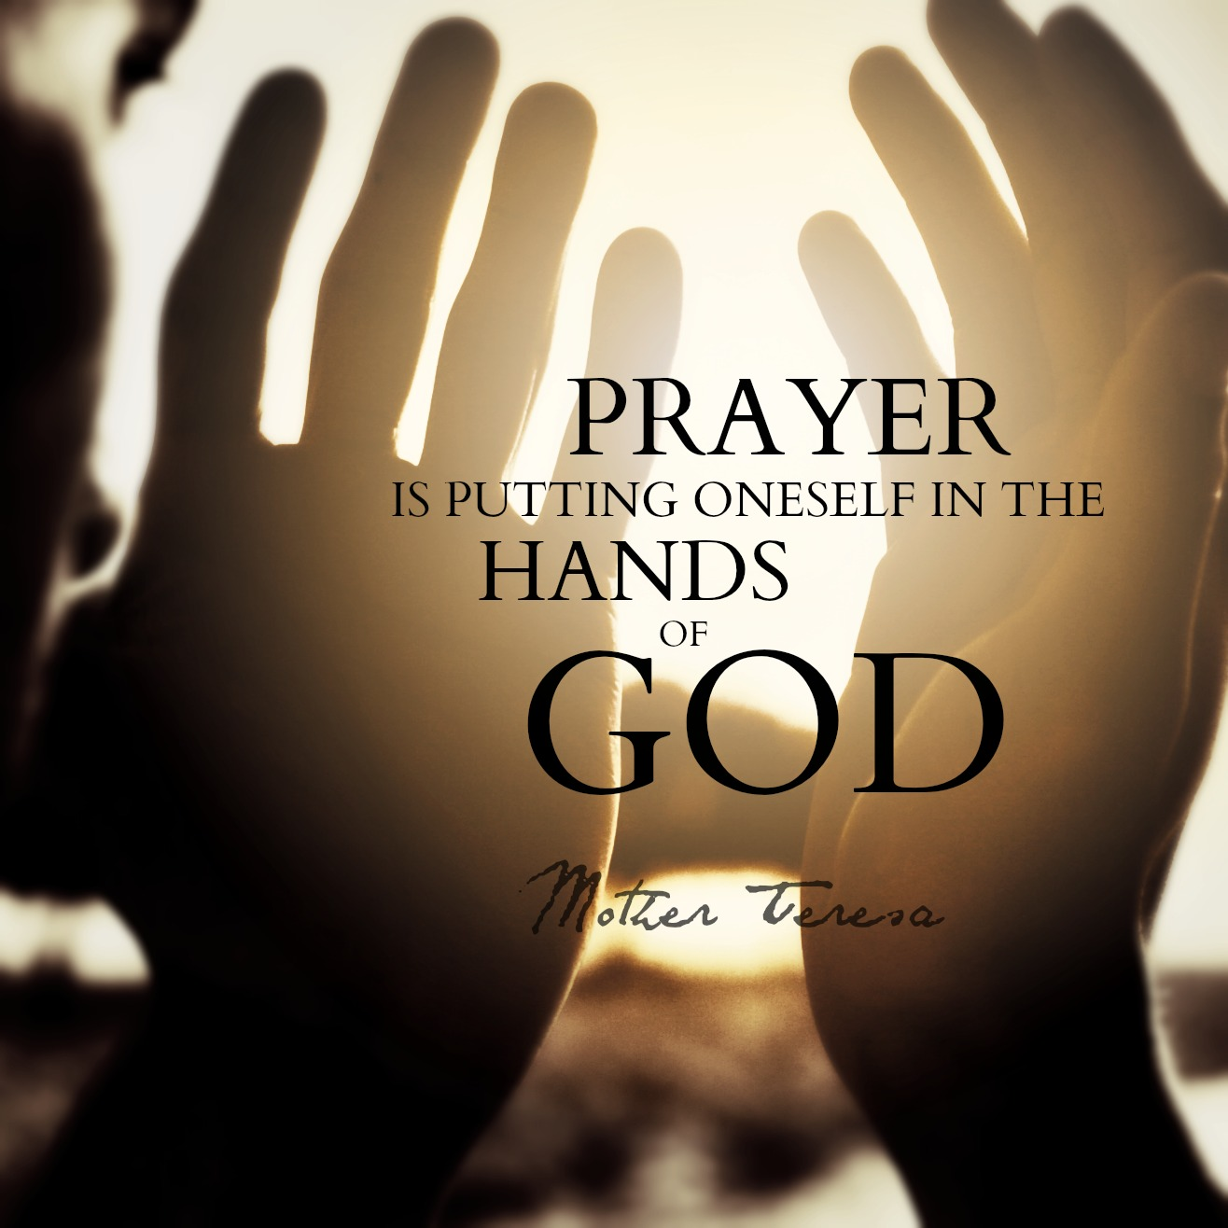

Slide 6
Latin for…
Happy Fault

Slide 7
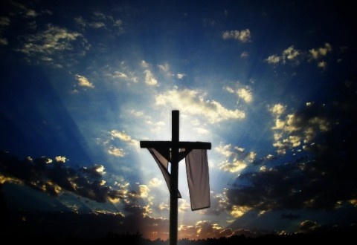
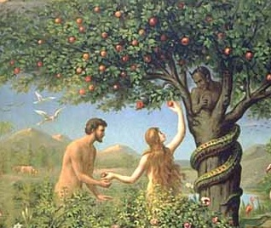
Original Sin brought about the Salvation of the World

Slide 8
God can transform your sin into something great!
“Sinners yes, corrupt no!”
“The name of God is Mercy”

Slide 9
The Wedding Feast at Cana is way more than Jesus’ first miracle. It is an example of the sacrament of Reconciliation

Slide 10
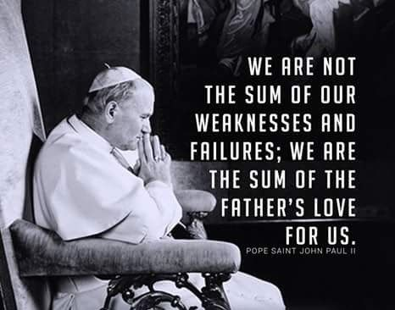

Slide 12
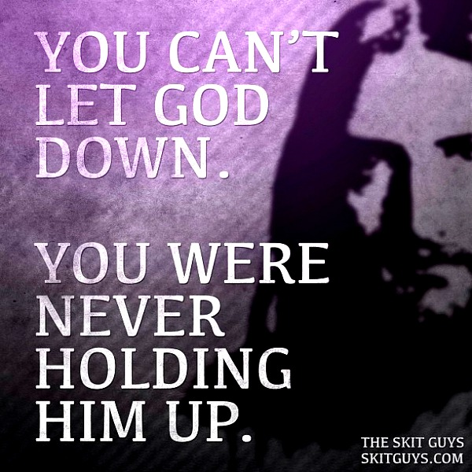
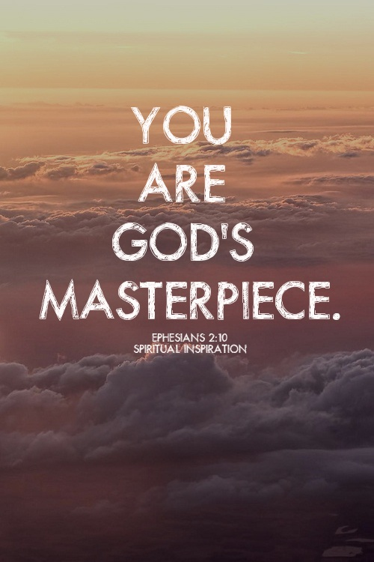
YOU ARE GOD’S ORIGINAL MASTERPIECE

Slide 13
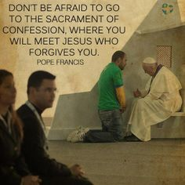
LENT: MERCY WITHIN THE CHURCH
Join us Tuesday for day two of our series
Presented by: Fr. Steven Roth

