Slide 1
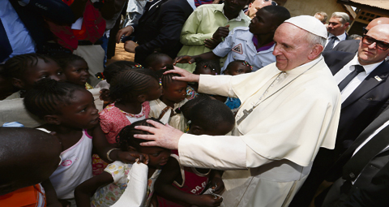
LENT: MERCY WITHIN THE COMMUNITY
Presented by: Fr. Steven Roth and
Jon Gerstmyer

Slide 3
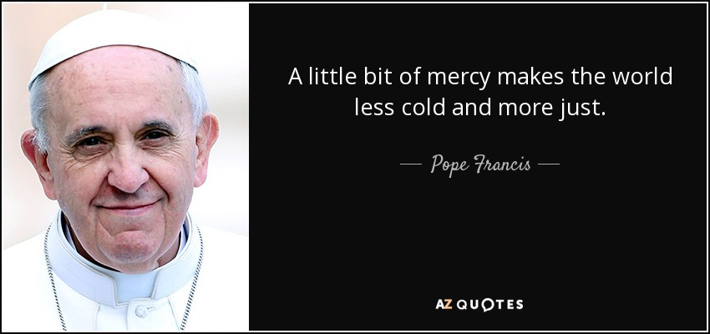
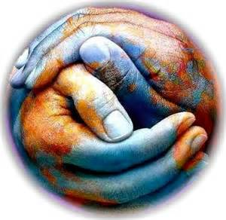

Slide 4
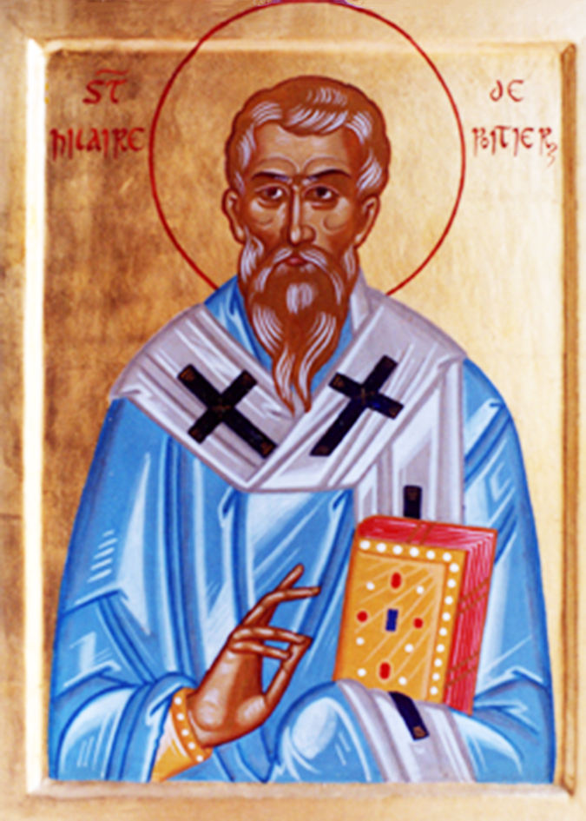
Fear does not mean we are to be afraid of God. Instead, it means that, having reflected on God’s love, we are people of awe.

Slide 5
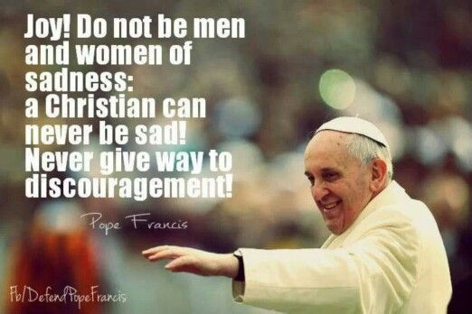

Slide 6
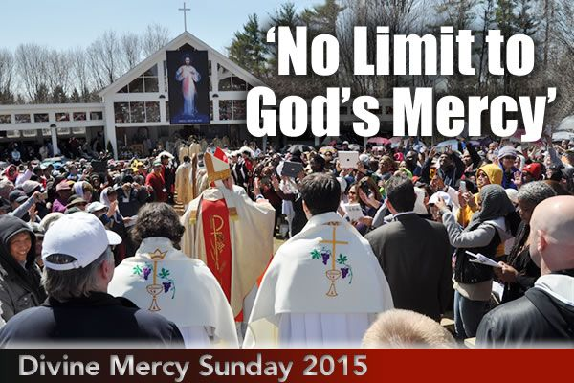

Slide 7
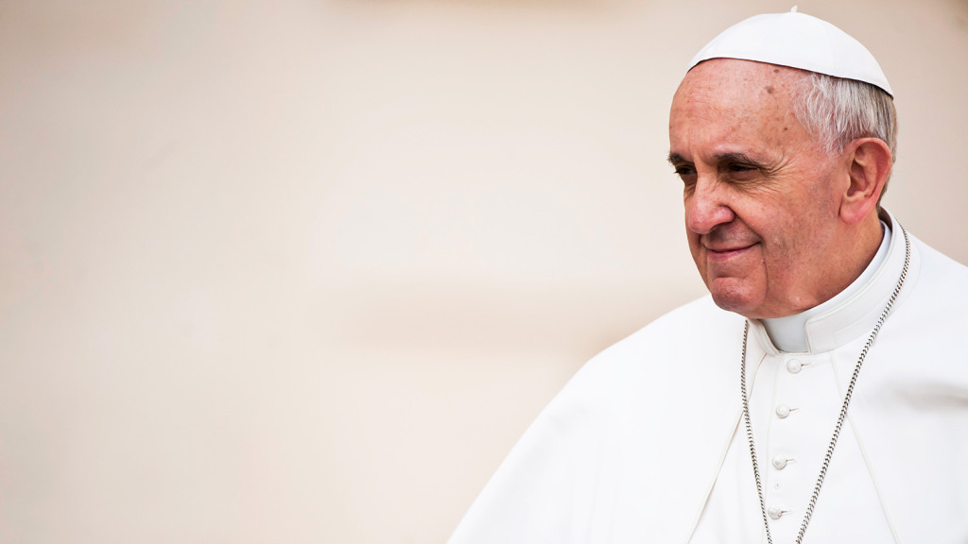
“situations can change, people can change. Be the first to seek to bring good. Do not grow accustomed to evil, but defeat it with good.”
~Pope Francis

Slide 8
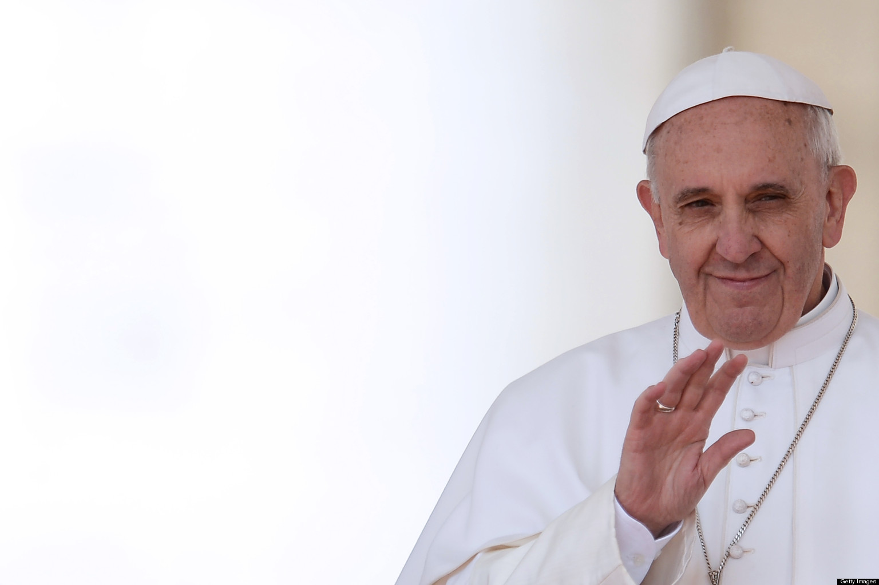
Mercy is not something we must invent. Rather, we look to the Lord and imitate Him in the present.
“What should I do= What would the Lord do?”
~Pope Francis

Slide 9
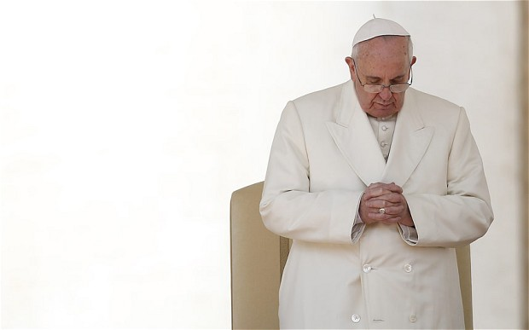
Mercy is not efficient. It will not always make sense or even be easy. It will cost us not just financially at times…it will cost us spiritually. Mercy stretches us. It will challenge us to grow and think differently.

Slide 11
Join us Wednesday for day three of our series
LENT: MERCY WITHIN THE COMMUNITY
Presented by: Fr. Steven Roth and Jon Gerstmyer

Slide 12
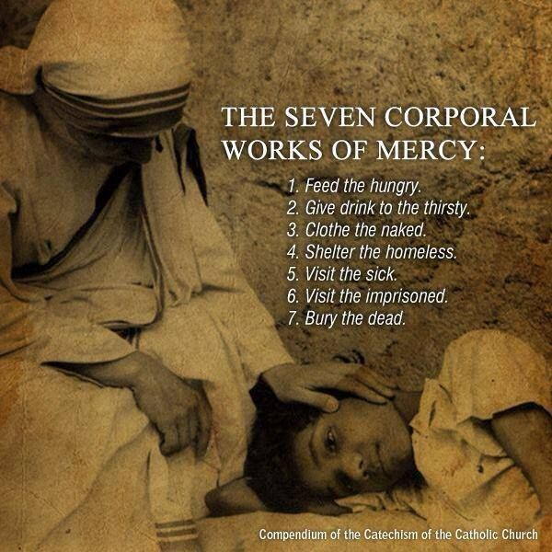

Slide 13
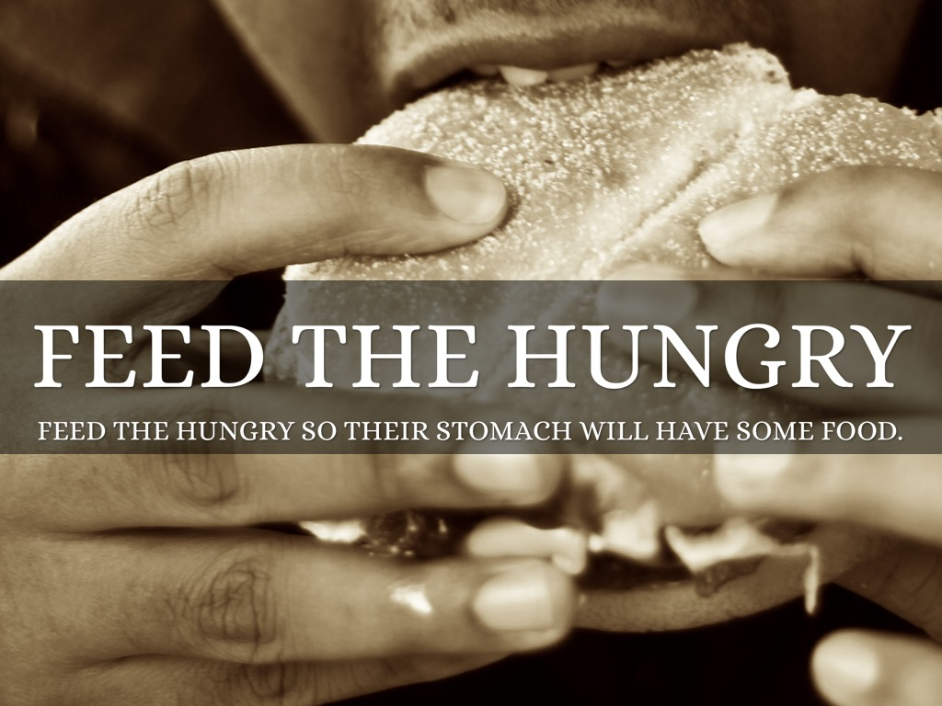
Join us Wednesday for day three of our series
LENT: MERCY WITHIN THE COMMUNITY
Presented by: Fr. Steven Roth and Jon Gerstmyer

Slide 14
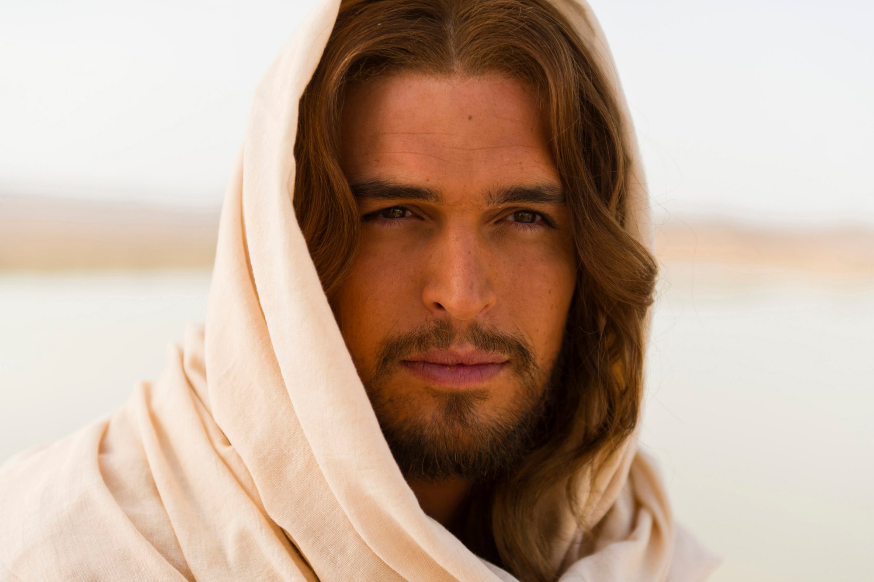
if you hunger and thirst after righteousness you will be filled, through Me.

Slide 15
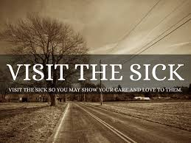

Slide 16
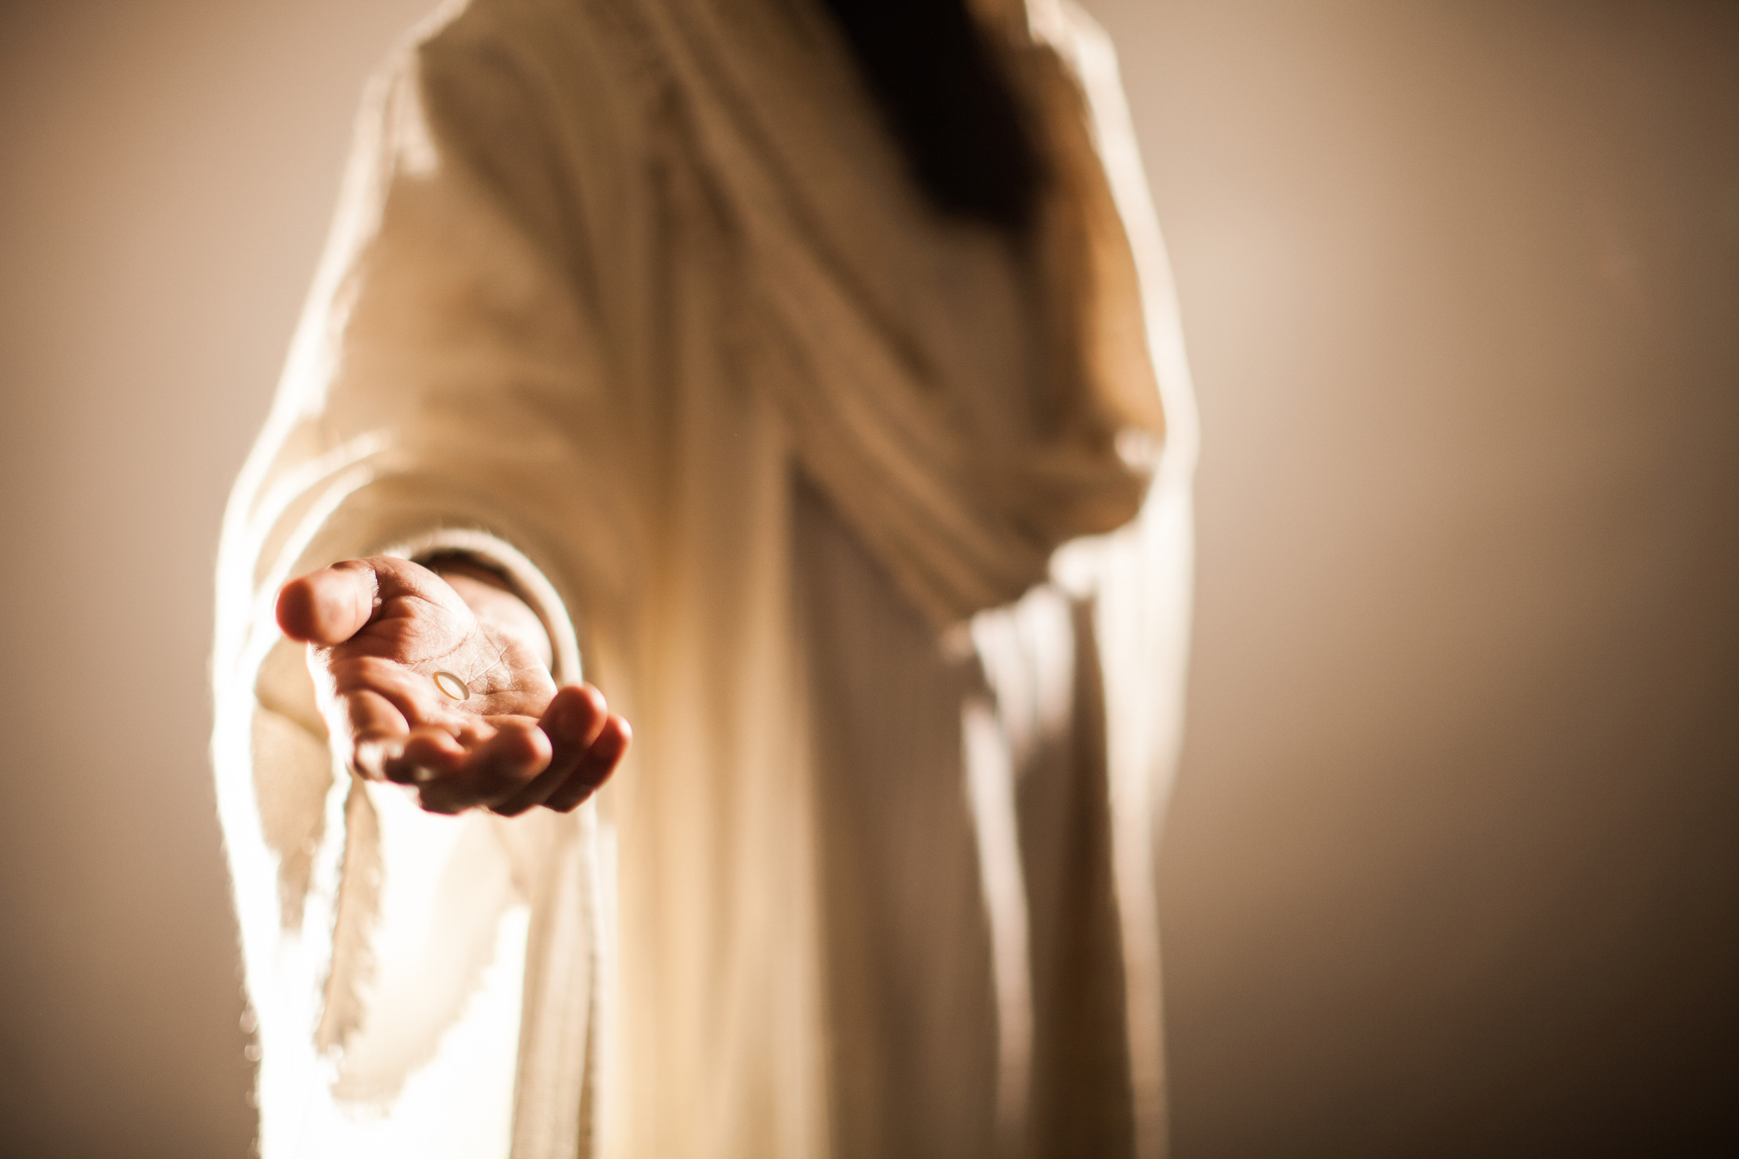
Bring them comfort.
Welcome them home.

Slide 17
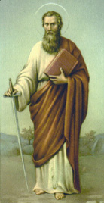
St. Paul is a great example of God’s mercy

Slide 20
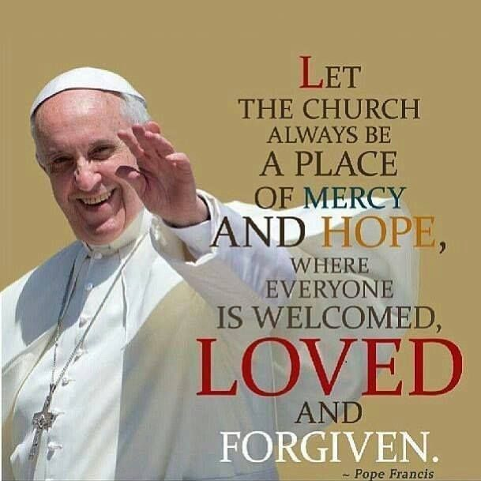
Join us Wednesday nights in May and June for
The 12 Apostles: Examples of God’s Mercy for Everyday Life
Presented by: Jon Gerstmyer

