Slide 1
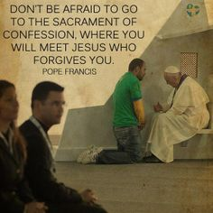
LENT: MERCY WITHIN THE CHURCH
Presented by: Fr. Steven Roth

Slide 5
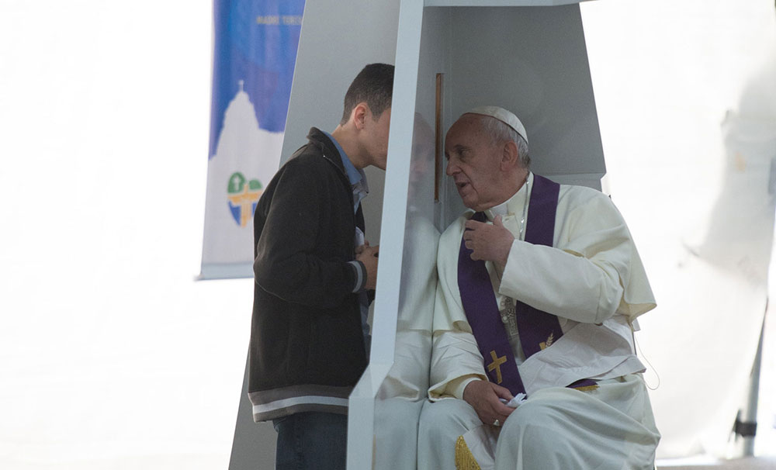
Mercy Within the Church

Slide 6
Who is the God of Mercy?
What does He look like?

Slide 7
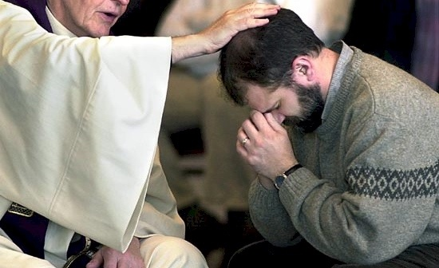
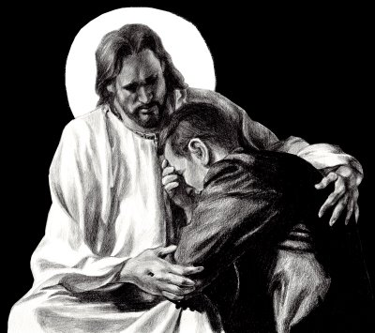
The greatest expression of mercy within the Church

Slide 8
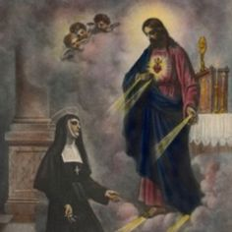
The sacred heart of Jesus appearing to St. Margaret Mary

Slide 9
“It is not easy to entrust oneself to God’s mercy, because it is an abyss beyond our comprehension. But we must! Oh I am a great sinner, all the better. Go to Jesus: He likes you to tell Him these things! He forgets, He has a special capacity for forgetting, He forgets, He kisses you, He embraces you!”
~Pope Francis

Slide 11
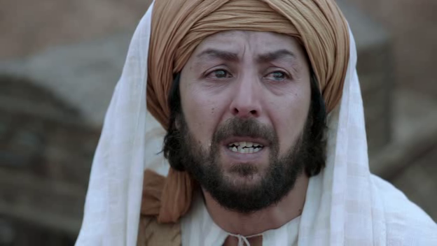
Have mercy on me, Lord. I am a sinner

Slide 12
“Jesus on the cross feels the whole weight of the evil, and with the force of God’s love He conquers it….This is the good Jesus does for us on the throne of the cross. Christ’s cross, embraced with love, never leads to sadness, but to joy, to the joy of having been saved.”
~Pope Francis

Slide 13
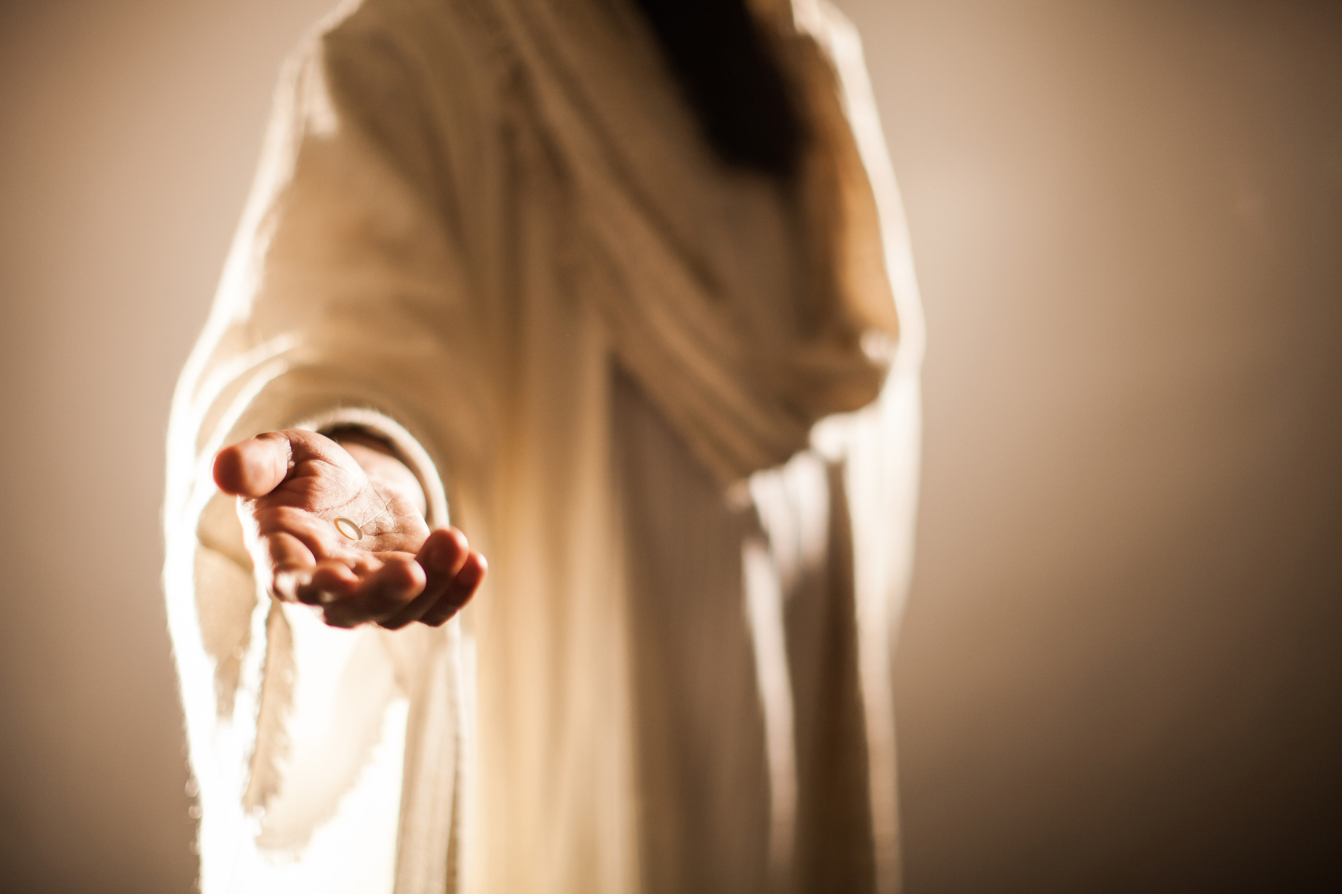

Slide 14
Discover God’s mercy in Scripture

Slide 15
Rediscover silence

Slide 16
Receive God’s mercy in Confession

Slide 17
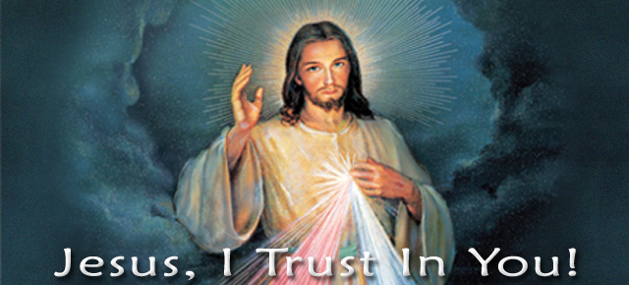

Slide 18
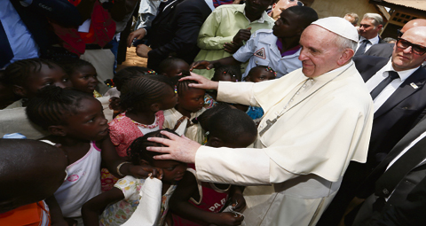
Join us Wednesday for day three of our series
LENT: MERCY WITHIN THE COMMUNITY
Presented by: Fr. Steven Roth and Jon Gerstmyer

