Slide 1
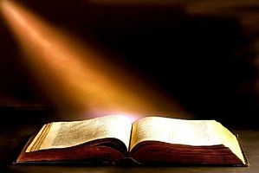
The Liturgy Explained
The Liturgy of the Word

Slide 3
The Liturgy Explained
“All scripture is inspired by God and is useful for teaching, for refutation, for correction, and for training in righteousness”
2 Tim 3:16
The Liturgy of the Word

Slide 4
Did God change?
Year A
Matthew
Year B
Mark (John 6)
Year C
Luke

Slide 5
The Readings
The first reading normally comes from the Old Testament
The second reading comes from the New Testament
The Gospel always comes from one of the four Gospels.

Slide 6
Year A 2017
Matthew
Year B 2018
Mark(John 6)
Year C 2016
Luke

Slide 7
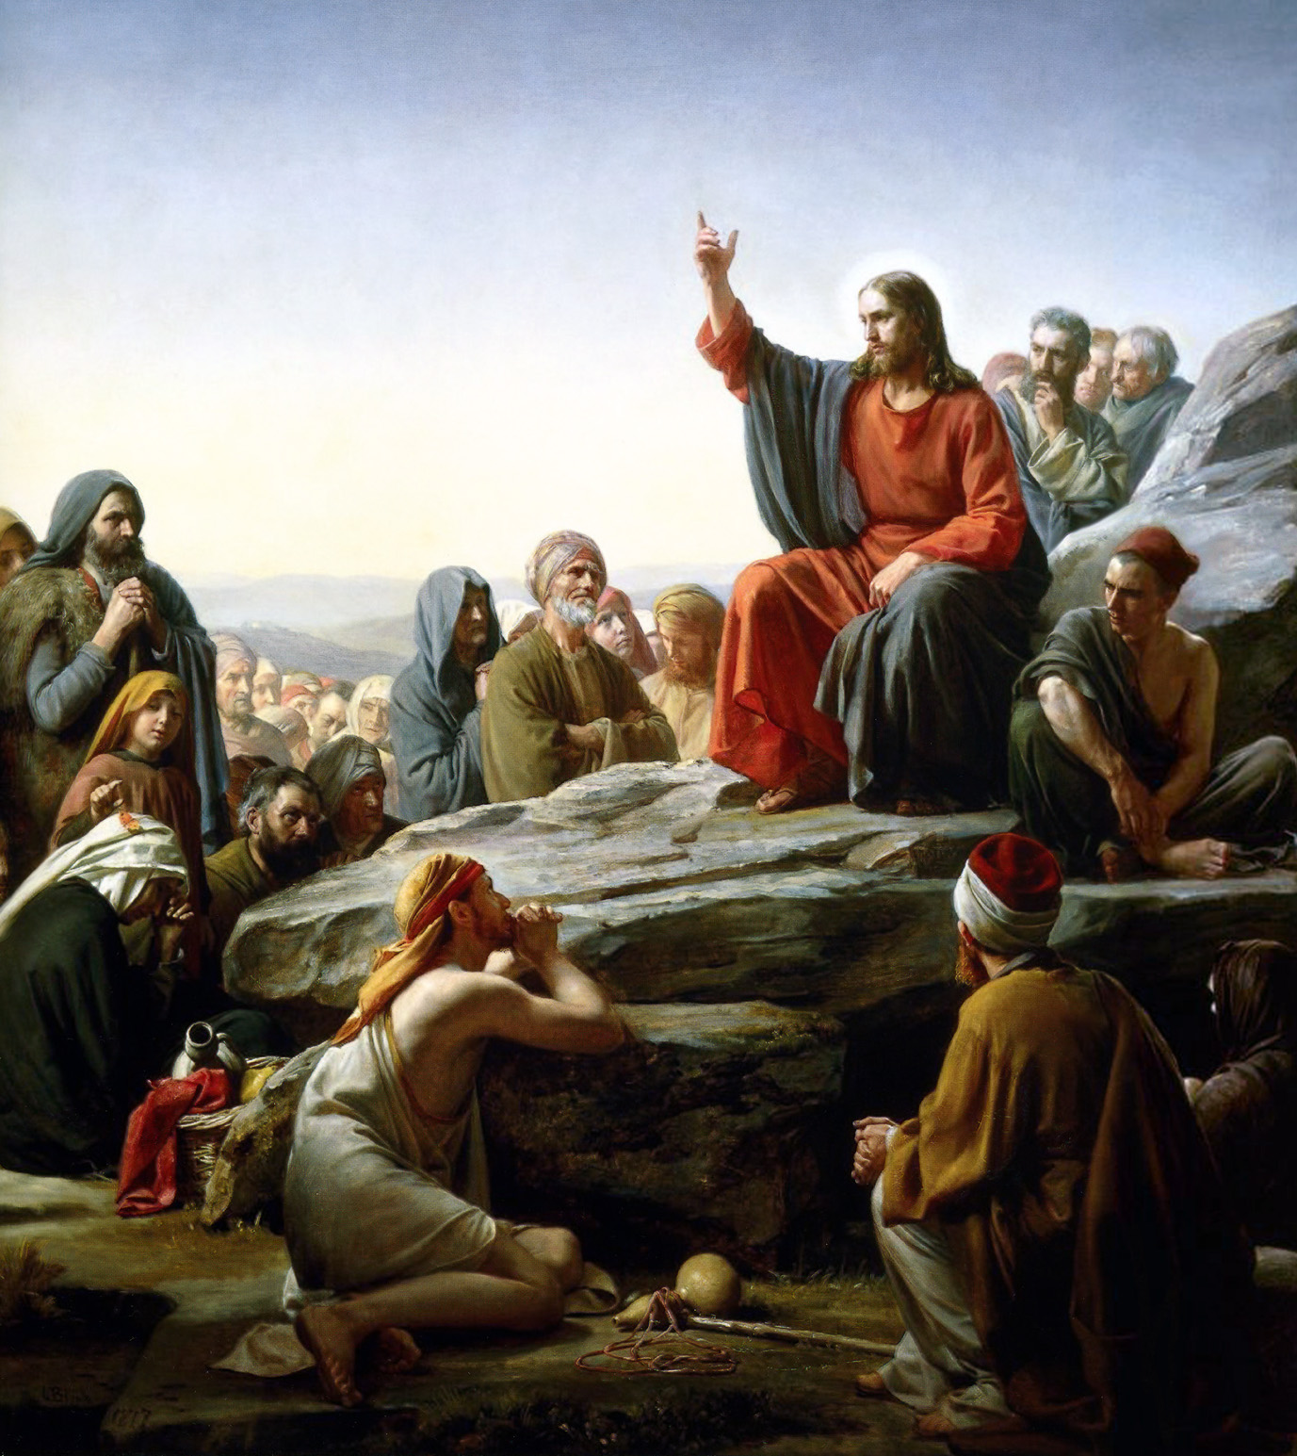
The Homily

Slide 8
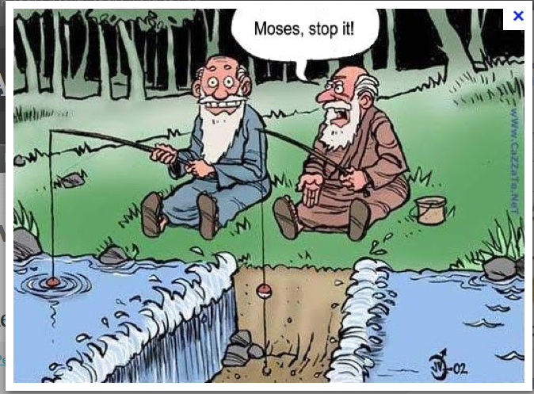
The Bible gets monotonous

Slide 10
Nicene Creed

Slide 11
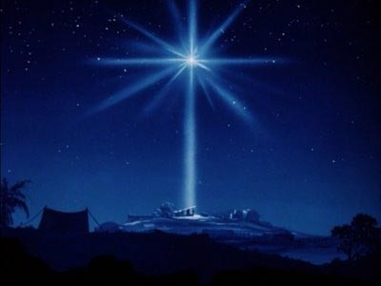
Nicene Creed
He came down from heaven and became man

Slide 13
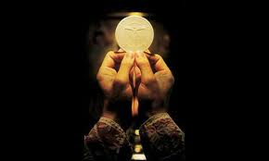
Join us next Wednesday for
The Liturgy of the Eucharist

