Slide 1
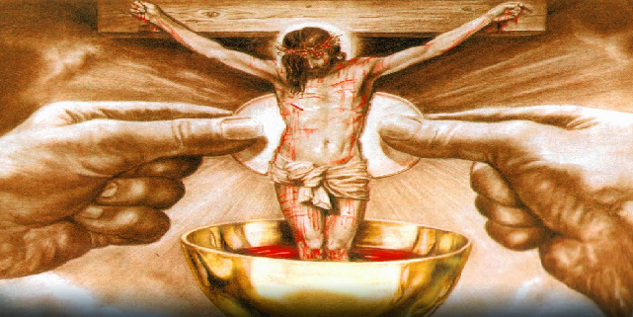
The Liturgy Explained
The Real Presence in the Eucharist

Slide 2
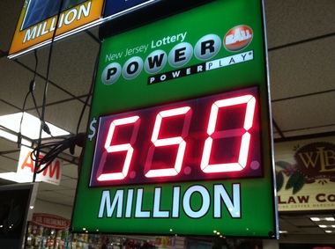

Slide 4
St. Paul’s conversion
An encounter with the Lord can open your heart, open your eyes, and change your life.
Acts 9

Slide 6
“For God to give us the Mass, it cost Him His Son’s life.” ~Fr. Larry Richards

Slide 7
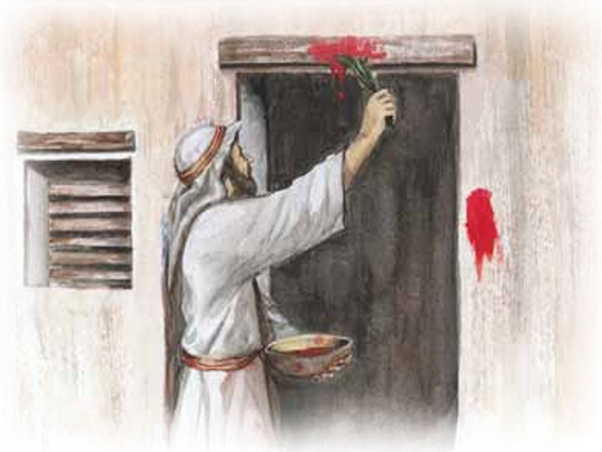
It was the blood of the lamb that saved the Israelites during Passover

Slide 8
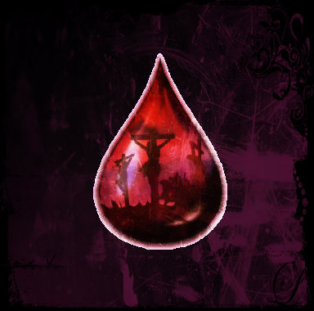
And it is the blood of the lamb that saves us. The blood that is present at each and every Mass we celebrate.

Slide 9
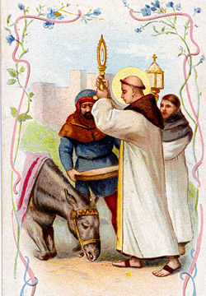
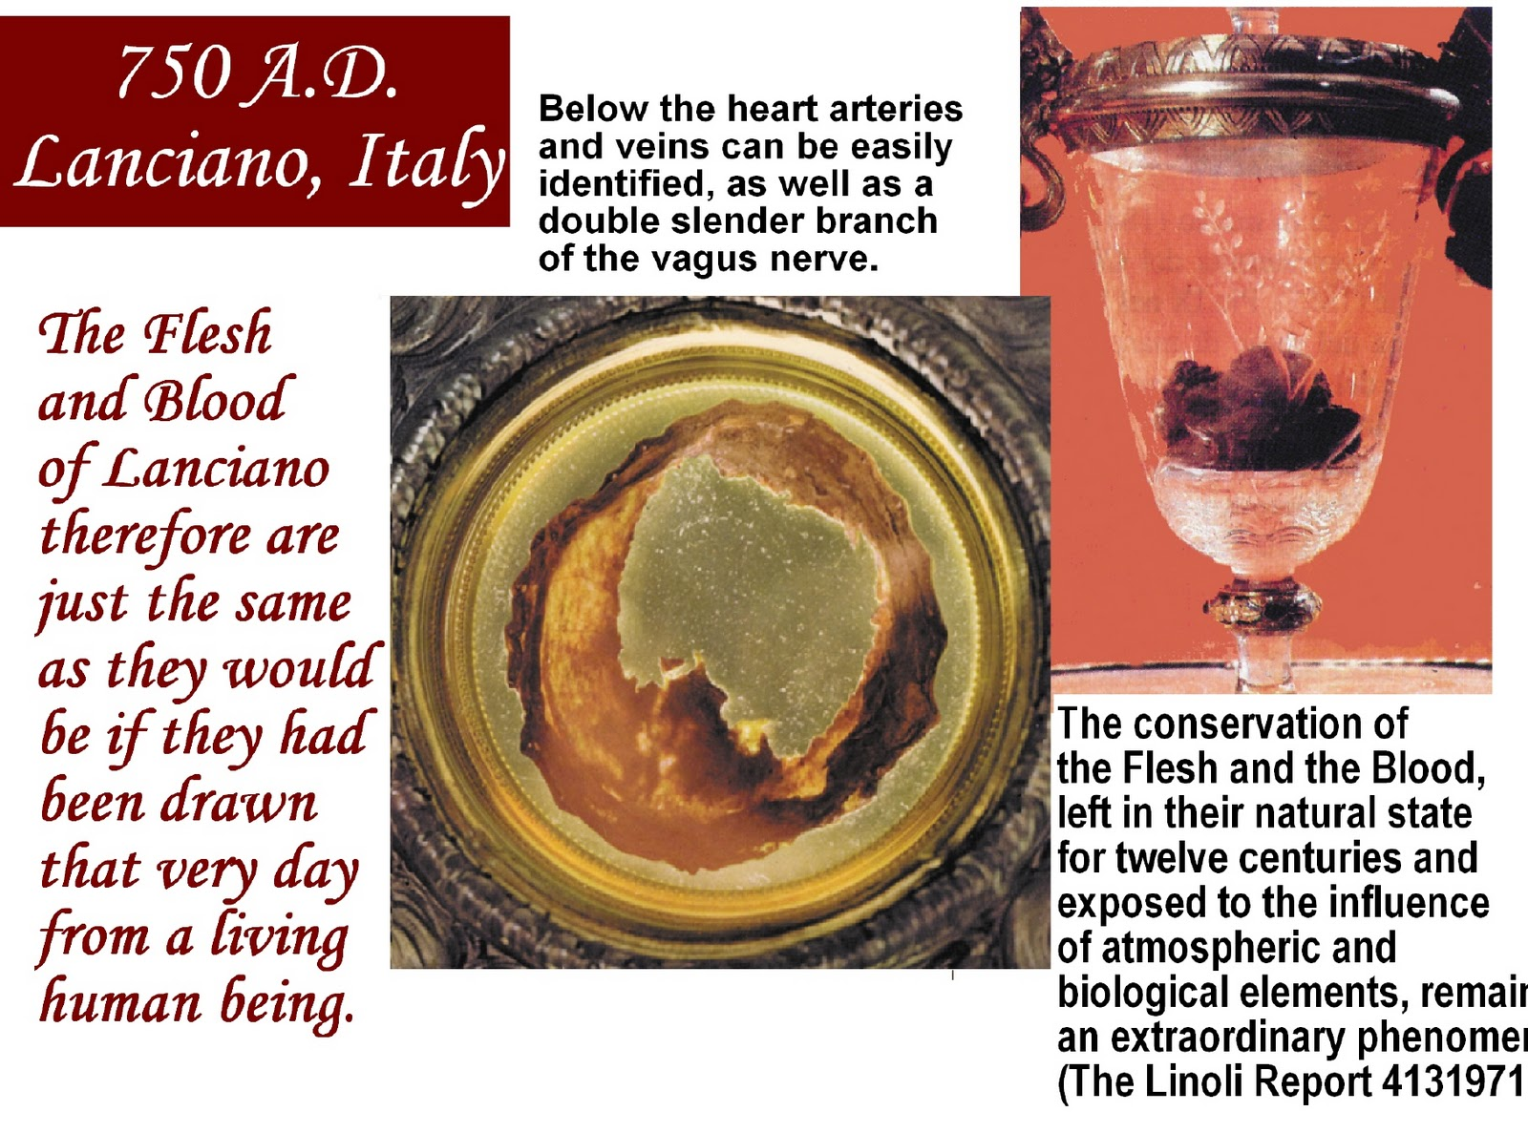
Eucharistic Miracles are reminders from God about His presence among us

Slide 10
Eucharistic Miracles are reminders from God about His presence among us

Slide 11
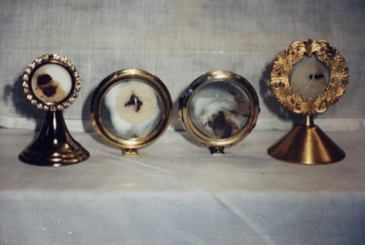
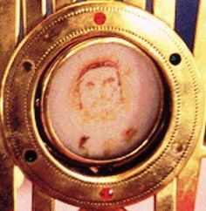
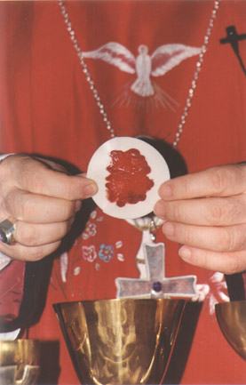
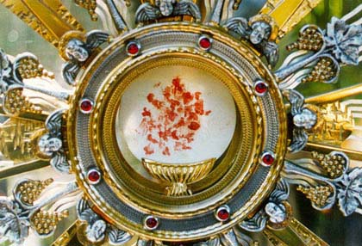
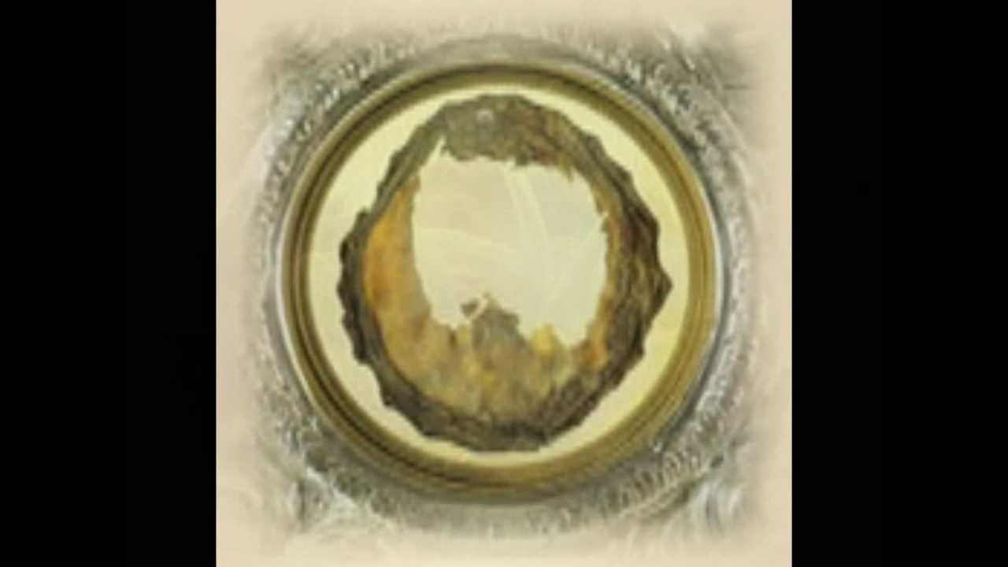
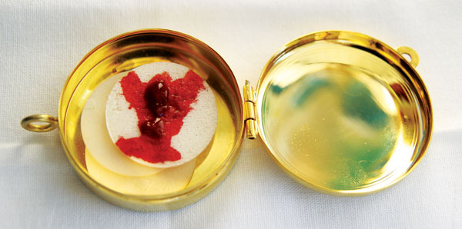
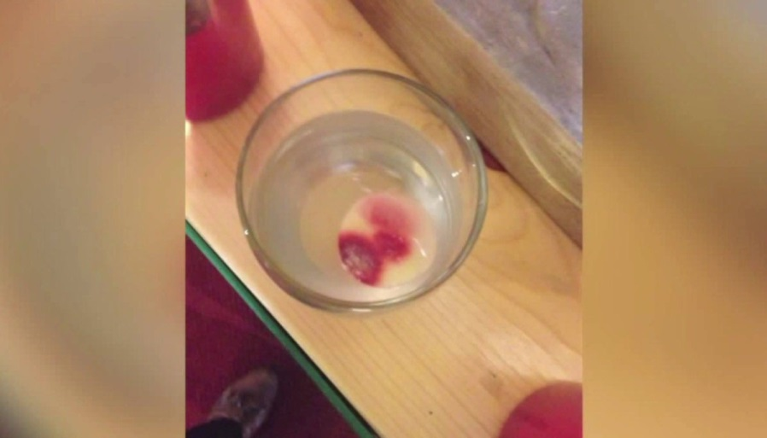

Slide 12
Join us next Wednesday for…

