Slide 1
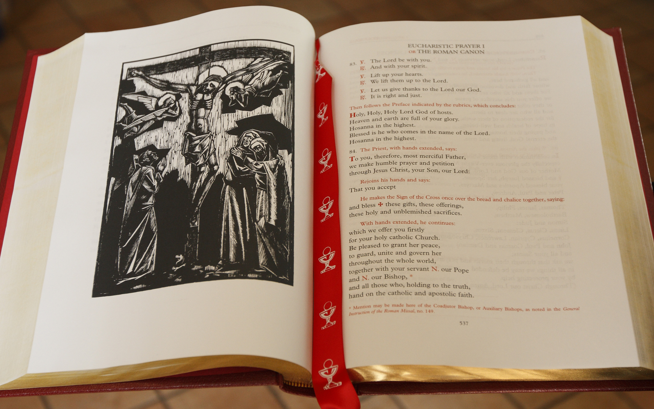
The Eucharistic Prayers

Slide 5
The Eucharistic Prayers(s)
The Roman Canon was solely used by the Roman Rite until Vatican II
The three new prayers are shorter that EPI
They put a stronger emphasis on the Holy Spirit’s role in Transubstantiation.
EPII – EPIV allow the people to interact more in during the prayer than they do in EPI
All are Trinitarian in nature

Slide 6
There are four Eucharistic Prayers
That are used throughout the Liturgical Year.
Eucharistic Prayer I: The Roman Canon dates back to the 5th Century
Eucharistic Prayer II: St. Hippolytus in the 3rd Century
Eucharistic Prayer III: Used most often
Eucharistic Prayer IV: St. Basil in the 4th Century

Slide 7
Eucharistic Prayer I: The Roman Canon
The longest of the Eucharistic Prayers
At one point it was the only Eucharistic Prayer used in the Western Church
From the 11th Century to 1969
Highly regarded for its theological precision, Biblical and Christian terminology
Follows the Gospel of Matthew
Strong sense of the Church of Messianic Fulfillment

Slide 8
The Roman Canon
92. then the priest, with hands extended, says: Therefore, o lord, as we celebrate the memorial of the blessed Passion, the Resurrection from the dead, and the glorious ascension into heaven of Christ, your son, our lord, we, your servants and your holy people, offer to your glorious majesty from the gifts that you have given us, this pure victim, this holy victim, this spotless victim, the holy Bread of eternal life and the Chalice of everlasting salvation.

Slide 9
The Roman Canon Proper Inserts

Slide 10
Eucharistic Prayer II: St. Hippolytus
Dates back to 215 A.D. and comes from the text of Hippolytus
It is the shortest EP
It is used mostly for weekdays, Children’s Masses, and small groups of people

Slide 11
Eucharistic Prayer III
Theme of sacrifice and the Holy Spirit
The Theology of Sacrifice is developed in the memorial offering and communion innvocations
We offer to God simple Bread and Wine that He has given to us (symbols of ourselves), and in return Jesus is returned to us as a sacrifice for us.
Regarded as the Eucharistic Prayer of Vatican II
Likened to the Gospel of Luke

Slide 12
Eucharistic Prayer IV: St. Basil
Longest of the three newer Eps
Though still considerably shorter than the Roman Canon
A synthetic presentation of the total movement of the History of Salvation
Gives the best picture of the Trinity
God created Man kind
Jesus Christ came for the salvation of Mankind
The Holy Spirit complete His work on earth

Slide 13
Eucharistic Prayers for Special Masses
Masses of Reconciliation
EP I – forgiveness of sin
EP II – reconciliation with Scriptural allusions
Masses for Children
EP I – Emphasis on Thanksgiving and simplest of the three
EP II – Mystery of God’s love
EP III – Stir up attention and enrich prayer
Solemnities and High Masses of the Liturgical Year
Roman Canon

