Slide 1
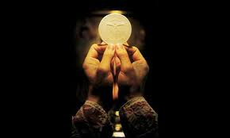
The liturgy Explained
The Liturgy of the Eucharist

Slide 2
The liturgy Explained
The Liturgy of the Eucharist

Slide 3
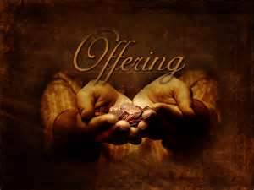
Offertory comes from the Latin word Offerre meaning to present, bring, or to offer

Slide 4
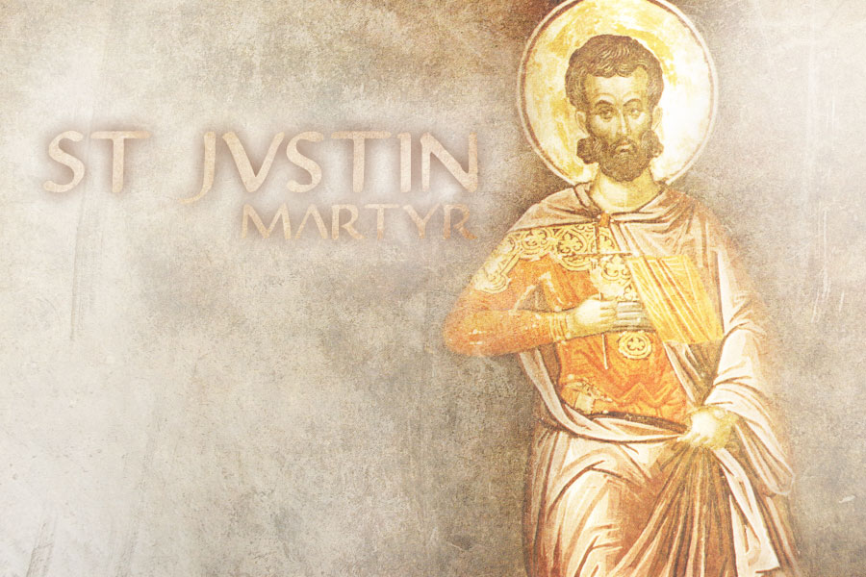
155 A.D. St. Justin Martyr mentioned the custom of someone bringing bread and wine to the priest after the intercessory prayers.

Slide 5
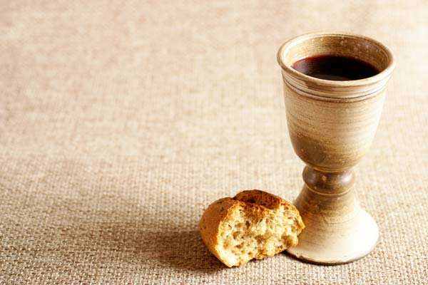
With bran flour make unleavened cakes mixed with oil, and unleavened wafers spread with oil Exodus 29:2

Slide 6
Now, this is what you shall regularly offer on the altar: two yearling lambs as the sacrifice established for each day; 39 one lamb in the morning and the other lamb at the evening twilight. 40 With the first lamb there shall be a tenth of an ephah of bran flour mixed with a fourth of a hin[f] of oil of crushed olives and, as its libation, a fourth of a hin of wine. 41 The other lamb you shall offer at the evening twilight, with the same grain offering and libation as in the morning. You shall offer this as a sweet-smelling oblation to the Lord.
Exodus 29:38-41

Slide 8
“With all possible emphasis, the sacrificing Priest exhorts us in this hour to lay aside all the cares of this life, all domestic worries, and direct our hearts to God in heaven who has loved men…. Let there be none among you who shall confess with his lips: We have lifted up our hearts, and allow his thoughts to remain with the cares of this life.” St. Cyril of Jerusalem

Slide 9
“We affirm that the activity most characteristic of God is to give His blessings. But that most fitting to creation is to give thanks, because that is the best it can offer him in return. For when creation tries to make any other return to God it finds that its gift already belongs to the Creator of the universe, not to the creature offering it. Since we now realize that to give due worship to God only one duty is incumbent upon us, that of giving thanks, we must carry it out in all times and in all places.” Philo

Slide 10
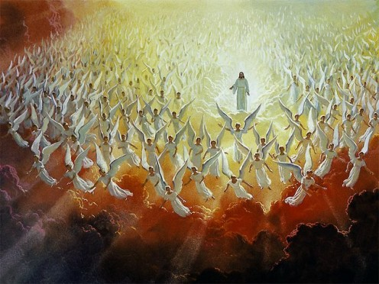
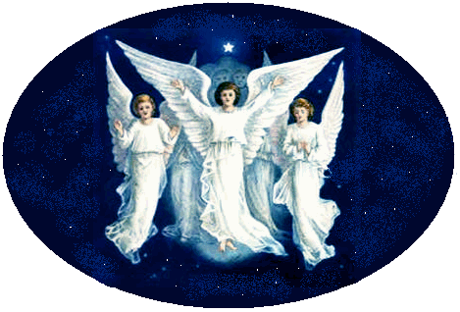
Sanctus
Isaiah 6, Revelation 4 Matthew 21

Slide 11
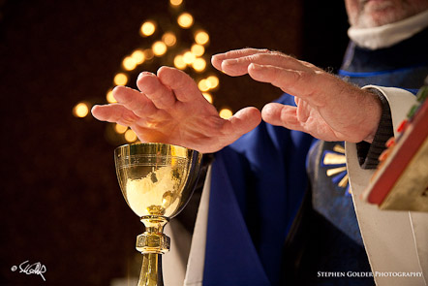
The Epiclesis

Slide 12
The Last Supper was a
Matthew 26

Slide 13
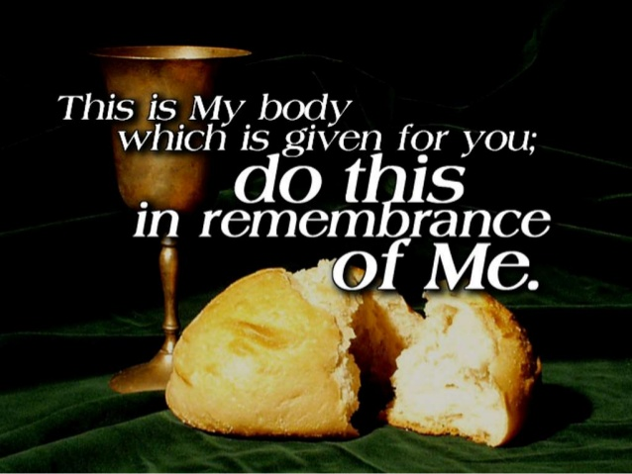

Slide 14
You’re worth dying for right now

